Slide 1
Integumentary System Review

Slide 2
What are the three layers of the skin?
Epidermis, Dermis, Hypodermis

Slide 3
Which layer of the epidermis will you find keratinized squamous cells?
Stratum corneum

Slide 4
What are the 5 functions of the skin?
Serve as a barrier, protect tissue underneath, sensory reception, Vitamin D production, thermoregulation

Slide 5
Which layer of the epidermis is responsible for producing new skin cells?
Stratum basale

Slide 6
Which type of gland is found all over the body and produces sweat that is mostly water and does not smell?
Eccrine

Slide 7
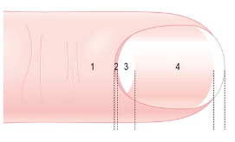
What structure of the nail is #3?
Lunula

Slide 8
Which type of gland is found attached to a hair follicle and is responsible for secreting sebum to keep your hair and skin and moisturized?
Sebaceous

Slide 9
If you have jaundice, what color skin tone will you have?
Yellow

Slide 10
Which type of burn is characterized by red skin that will heal within 3-4 days?
1st degrees

Slide 11
Which type of skin cancer is considered the most dangerous because it has the highest risk for fatality?
Malignant melanoma

Slide 12
What skin condition is caused by a fungal infection?
Tinea

Slide 13
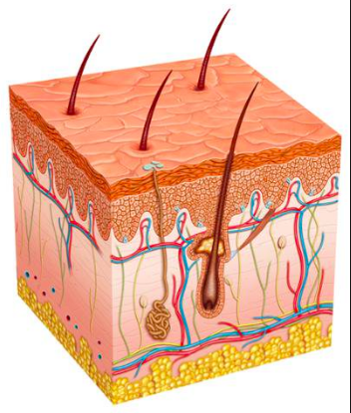
What structure is the arrow pointing to?
Hair shaft

Slide 14
What is the main sign/symptom for urticaria?
Red wheals/welts on the body

Slide 15
What is the role of melanin?
Protect the DNA in the nucleus (by forming a cap over it) from UV radiation

Slide 16
True or False? The dermis is avascular.
False.

Slide 17
What is responsible for skin color?
Amount of melanin produced AND type of melanin produced

Slide 18
Where are melanocytes found?
Stratum basale

Slide 19
What is the function of the hair found on your eyebrows and eyelashes?
Keep perspiration out of your eyes

Slide 20
Where would you find sebaceous glands?
Attached to a hair follicle

Slide 21
Which type of skin cancer is most common?
Basal cell carcinoma

Slide 22
True or False? The nail bed is the part of the nail that we can see.
False

Slide 23
What structure is the arrow pointing to?
Eccrine gland

