Slide 1
The muscular system
“You got tickets…?”

Slide 2
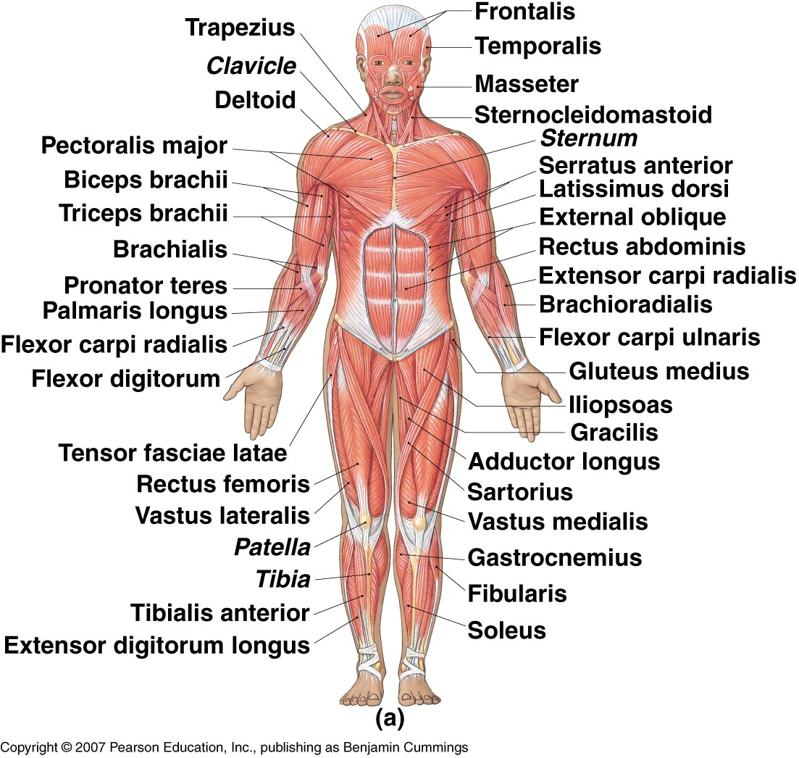

Slide 3
Muscular System
Muscles are responsible for all types of body movement
3 basic muscle types are found in the body
Skeletal muscle
Smooth muscle
Cardiac

Slide 4
Skeletal Muscle
Attached to the skeleton
Voluntarily (consciously) controlled
Microscopically the tissue appears striated
Cells are long, cylindrical, & multi-nucleated

Slide 5
Smooth Muscle
Makes up the walls of organs and blood vessels
Involuntarily (unconsciously) controlled
Microscopically the tissue appears non-striated
Cells are short, spindle-shaped, and have a single nucleus
Tissue is extremely extensible while still retaining its ability to contract

Slide 6
Cardiac Muscle
Makes up the myocardium of the heart
Involuntarily (unconsciously) controlled
Microscopically the tissue appears striated
Cells are short, branching, and have a single nucleus
Cells connect to each other at intercalated discs

Slide 7
Functions of the Muscular System
Movement - both involuntary and involuntary
Maintaining posture
Maintaining body temperature
Supporting soft tissues within body cavities
Guarding entrances and exits of the body

Slide 8
Functions of Skeletal Muscle
For this unit we will be focusing just on skeletal muscle.
Functions of just the skeletal muscle include:
Produce movement
Maintain posture
Stabilize joints
Generate heat

Slide 9
Muscle Attachment
Sites of muscle attachment
Bones
Cartilage
Connective tissue coverings
Muscle fibers blend into a connective tissue attachment
Tendon – cordlike structure that attaches the muscle to bone
Aponeurosis – sheet-like structure

Slide 10
Characteristics of Muscle Tissue
Excitability - can receive and respond to stimulation
Contractility - can shorten to exert a pull
Extensibility - can lengthen
Elasticity - returns to original length after contraction

Slide 11
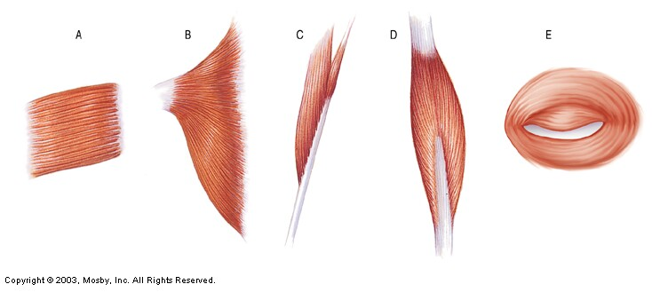
Muscle Fiber Arrangement
Parallel
Convergent
Pennate
Bipennate
Sphincter

Slide 12
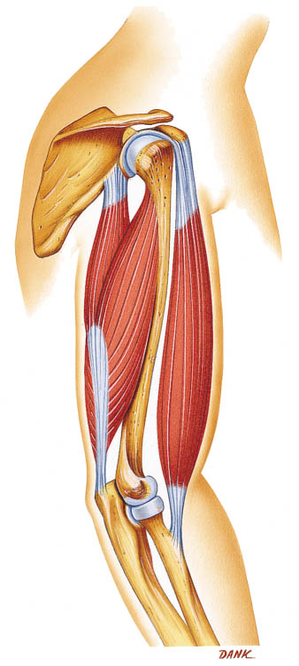
Skeletal Muscle Actions
Origin – muscle attachment that remains fixed (does not move)
Insertion – muscle attachment that moves on contraction
Action – body movement that a muscle produces
Flexion, extension, abduction, adduction, etc.

Slide 13
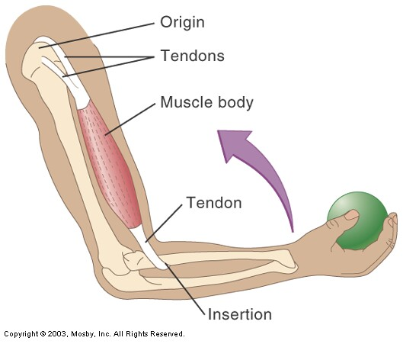
Does NOT move when
muscle contracts
Does move when
muscle contracts

Slide 14
Naming Muscles
Location – structure near which the muscle is found
Frontalis | Frontal bone
Femoris | Femur
Gluteus | Posterior of hip/thigh
Oculi | Eye
Oris | Mouth
Radialis | Radius
Ulnaris | Ulna
Brachialis | Arm

Slide 15
Naming Muscles
Function – body movement when the muscle is contracted
Abductor | Moves part away from body
Adductor | Moves part toward body
Depressor | Lowers a part
Extensor | Extends a part
Flexor | Flexes a part
Levator | Elevates a part
Rotator | Rotates a part

Slide 16
Naming Muscles
Shape – relative shape of the muscle
Deltoid | Shaped like delta ∆
Orbicularis | Circular
Serratus | Saw-toothed
Quadratus | Square
Rhomboideus | Diamond-shaped
Trapezius | Trapezoidal

Slide 17
Naming Muscles
Size – relative size of the muscle
Brevis | Short
Longus | Long
Magnus | Large
Maximus | Largest
Medius | Moderately sized
Minimus | Smaller

Slide 18
Naming Muscles
Fiber direction – relative to the midline
Oblique | Diagonal to midline
Rectus | Parallel to midline
Sphincter | Circling an opening
Transversus | Right angle to midline

Slide 19
Naming Muscles
Number of heads/origins
Bicep | Two heads
Tricep | Three heads
Quadricep | Four heads

Slide 20
Naming Muscles
Muscle names can be
any combination of the
options listed!

Slide 21
Let’s quiz ourselves!
How are the following muscles named?
Biceps femoris
Flexor carpi ulnaris
Gluteus maximus
Abductor magnus
Rhomboid major

Slide 22
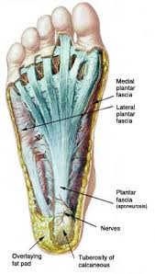
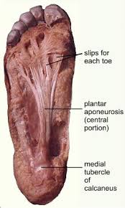
Structure of Skeletal Muscle
Connective Tissue
Fascia – Dense connective tissue that surrounds and separates each muscle
Extends beyond the ends of the muscle and gives rise to tendons
Tendons – fused to the periosteum of bones, therefore connecting muscle to bone
Aponeuroses – broad sheets of connective tissue that connect muscle to muscle or muscle to bone

Slide 23
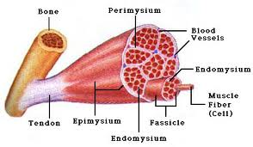
Structure of Skeletal Muscle
Epimysium – layer of connective tissue underneath that fascia that surrounds each muscle
Perimysium – layer of connective tissue that surrounds individual bundles (fascicles) within each whole muscle
Endomysium – layer of connective tissue that covers each muscle cell (muscle fiber)

Slide 24
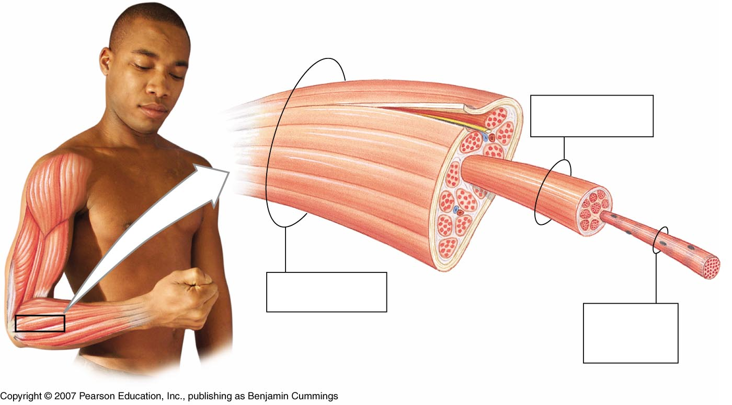
Structure of Skeletal Muscle
epimysium
tendon
perimysium
Muscle Fascicle
Surrounded by perimysium
Skeletal muscle
endomysium
Surrounded by epimysium
Skeletal muscle fiber (cell)
Surrounded by endomysium

Slide 25
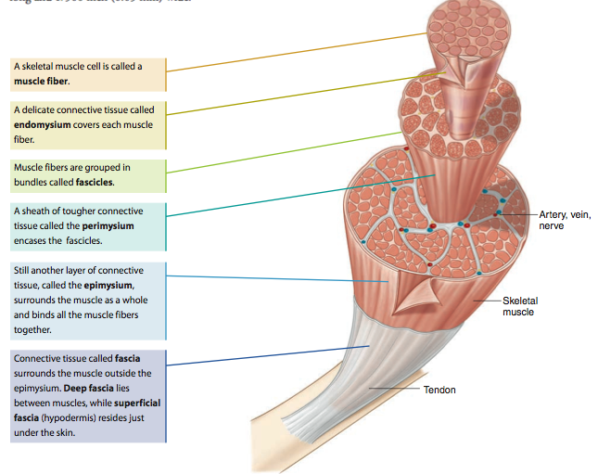

Slide 26
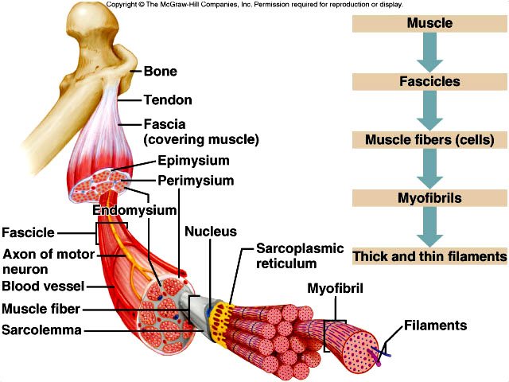

Slide 27
Skeletal Muscle Fibers
Beneath the sarcolemma (cell membrane) is the sarcoplasm (cytoplasm) and transverse (T) tubules
The SR and T-tubules activate the muscle contraction mechanism when the fiber is stimulated.
Notes:
----- Meeting Notes (1/13/14 12:51) -----
title the slide - "Structure of Muscle Fiber/Muscle Cell"

Slide 28
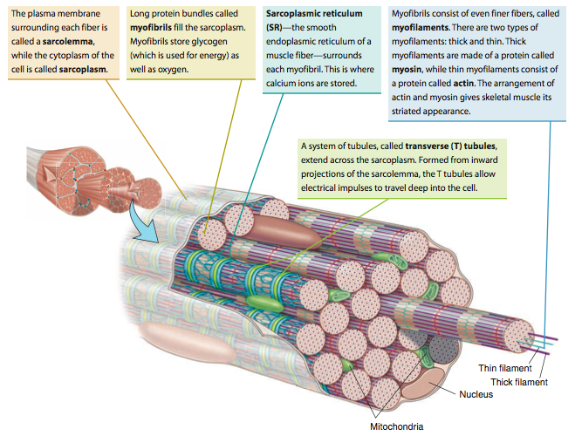

Slide 29
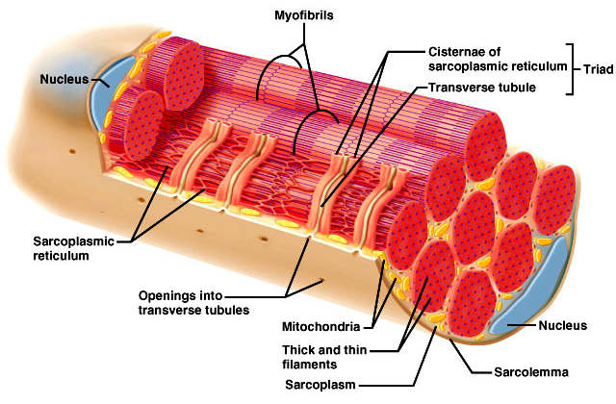

Slide 30
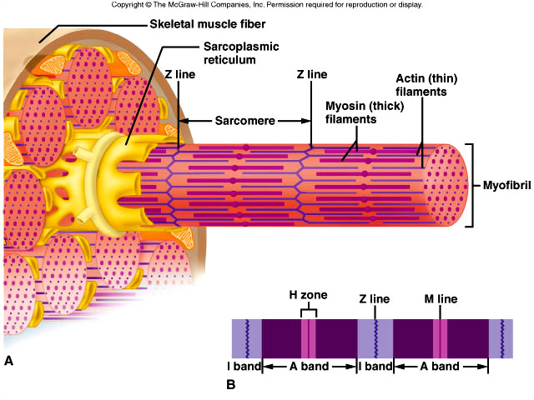
Skeletal Muscle Fibers
The sarcoplasm of each muscle fiber/muscle cell contains myofibrils (rod-like units of muscle)
Myofibrils are separated into compartments called sarcomeres that contain thick filaments and thin filaments
Thick filaments – made of protein called myosin
Thin filaments – made of protein called actin
The organization of these thick and thin filaments produces striations.

Slide 31
Skeletal Muscle Fibers
A sarcomere extends from Z line to Z line
I bands (light bands) are anchored to the Z lines and are length of actin filaments
A bands (dark bands) are the length of myosin filaments

Slide 32
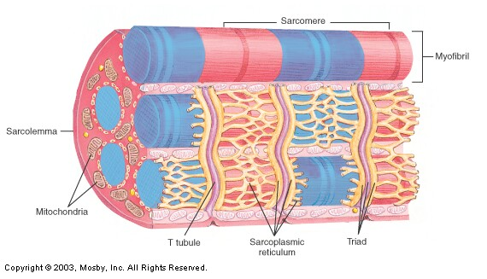
Z line
Z line
I band
A band
Length of myosin heads (wide, dark stripes)
Length of actin (thin, light stripes)

Slide 33
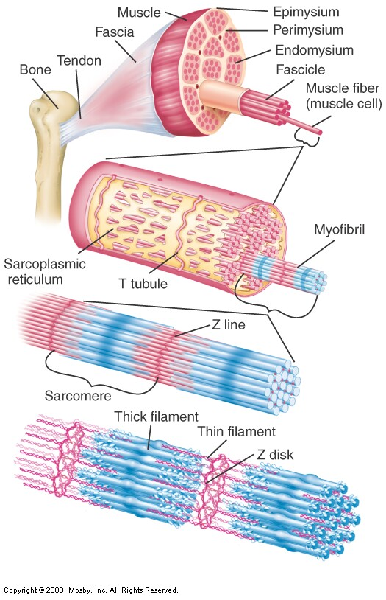

Slide 34
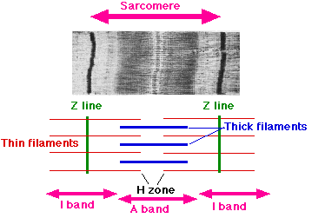

Slide 35
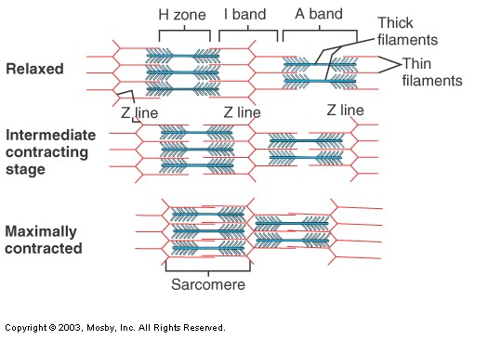

Slide 36
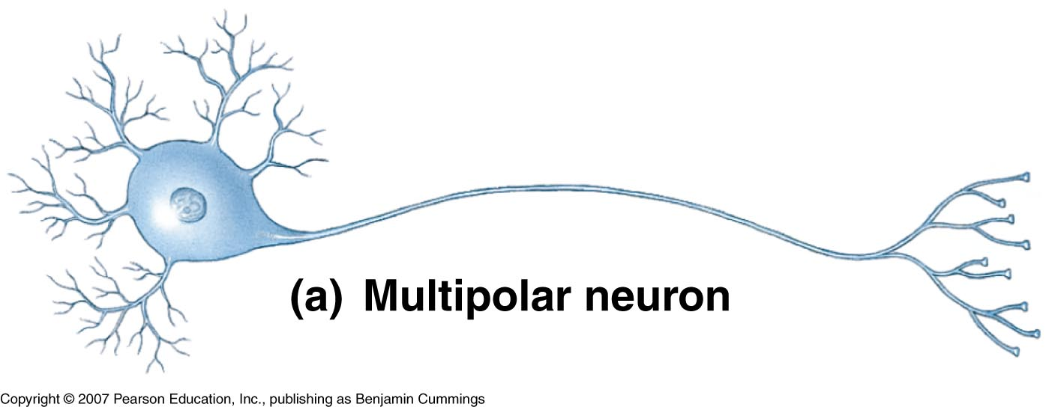
Neuromuscular Junction
Motor neurons – the cells that cause muscle fibers to contract
What type of cells are these? What do they look like?
Root word “Neuro”?
The axon of the motor neuron extends outward from the brain or spinal cord. The muscle fiber will only contract when stimulated by the motor neuron.
(motor neuron)

Slide 37
Neuromuscular Junction
The site where the motor neuron and muscle fiber meet is the neuromuscular junction
The muscle fiber membrane forms a motor end plate
The sarcolemma (cell membrane) is tightly folded
Abundant nuclei and mitochondria
The end of the motor neuron branches into the motor end plate.
The cytoplasm has abundant mitochondria and contains many tiny synaptic vesicles that store neurotransmitters

Slide 38
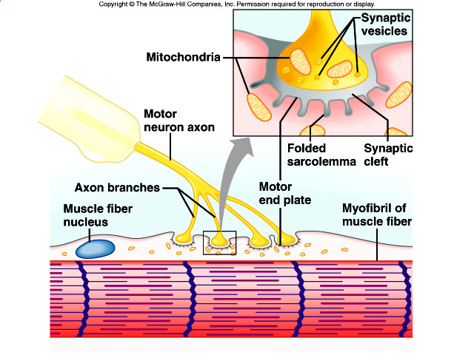

Slide 39
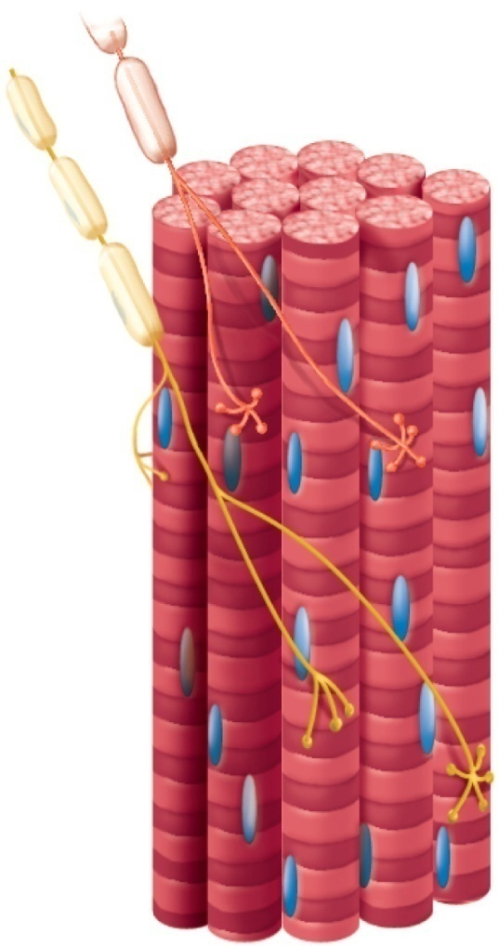
Neuromuscular Junction
A motor neuron and the muscle fibers that it controls make up a motor unit
A motor neuron may connect to as few as 4 muscle fibers and as many as 1000s of muscle fibers
When stimulated to do so, the muscle fibers of the motor unit contract all at once

Slide 40
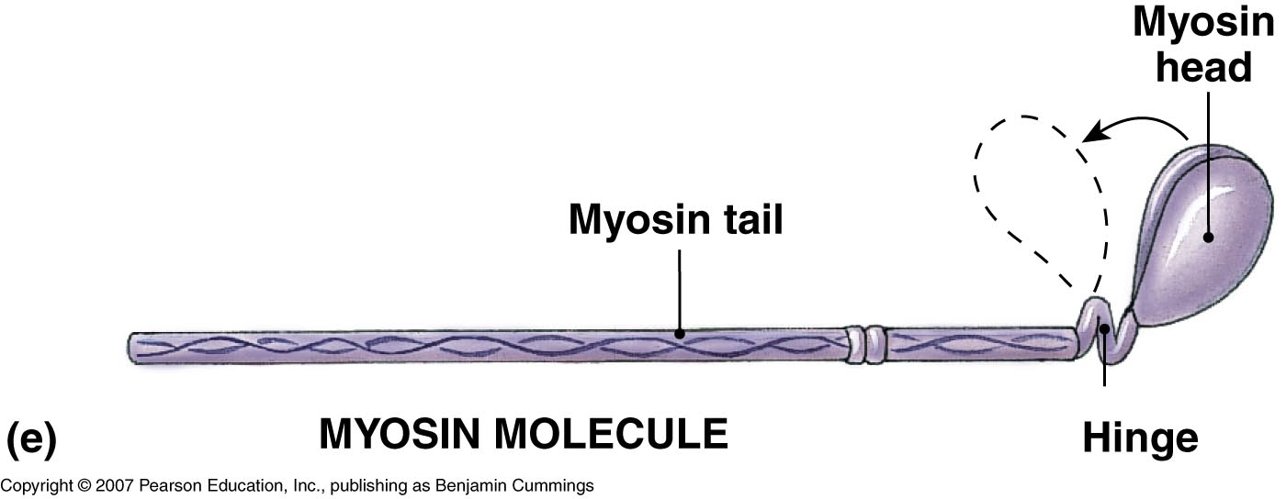
Skeletal Muscle Contraction
Role of Myosin and Actin
Myosin consists of two twisted strands with cross-bridges projecting outward

Slide 41
Skeletal Muscle Contraction
Role of Myosin and Actin
Actin is a protein with binding sites that the myosin cross-bridges attach to
Contains 2 proteins – troponin and tropomyosin

Slide 42
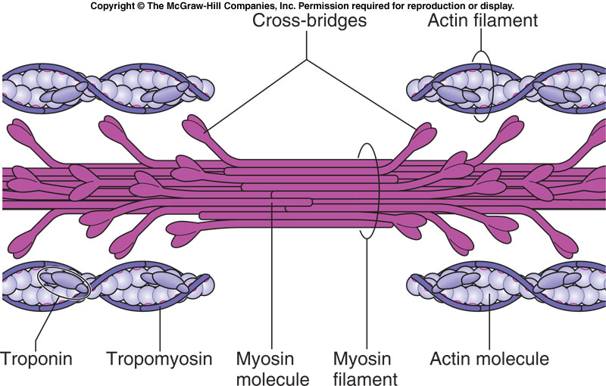
Skeletal Muscle Contraction

Slide 43
Video

Slide 44
Sliding Filament Theory
Myosin heads attach to actin molecules at a binding site
Cross-bridge bends and pulls actin, causing the actin filament to slide across the myosin, toward the center of the sarcomere, causing it to shorten (Z lines move closer together).
Myosin releases… attaches to new binding site and pulls again
Energy is provided from the conversion of ATP to ADP
Releases a ton of energy!!
Energy is needed to properly position myosin cross-bridge so that in can bind with actin
Cycle of “grab and release, grab and release” will continue as long as ATP is available

Slide 45
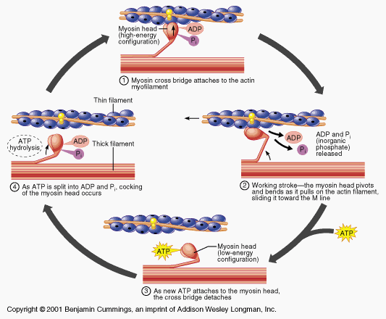
Sliding Filament Theory

Slide 46
Stimulus for Contraction
In skeletal muscle, neurotransmitter = Acetylcholine (ACh)
Nerve impulse travels down motor neuron to the neuromuscular junction
ACh is released from synaptic vesicles
ACh binds to Ach receptors on the motor end plate which generates a muscle impulse
Muscle impulse travels down the T-tubule (through the muscle fiber) and eventually reaches the sarcoplasmic reticulum
Notes:
Neurotransmitter: a chemical substance that is released at the end of a neuron by a nerve impulse and, by diffusing across the synapse, causes the transfer of the impulse to another fiber (muscle fiber in this case)

Slide 47
Stimulus for Contraction
Muscle impulse causes the sarcoplasmic reticulum to release calcium ions
Calcium ions bind to troponin and change its shape
This causes the position of tropomyosin to be altered
Binding sites on actin are now exposed
Actin and myosin bind via the myosin cross-bridges

Slide 48
Stimulus for Contraction
Myosin cross-bridge pulls the actin filament causing them to slide over the myosin filament
Sarcomeres shorten in length
New ATP binds to myosin
Actin and myosin break apart
ATP splits which provides energy
Myosin cross-bridge goes back to original position

Slide 49
Relaxation
Acetylcholinesterase – rapidly decomposes Ach remaining in the synapse
Muscle impulse stops
Stimulus to sarcolemma and muscle fiber membrane ceases
Calcium moves back into sarcoplasmic reticulum
Myosin and actin binding prevented
Muscle fiber relaxes

Slide 50
Energy Sources for Contraction
Energy for contraction comes from ATP molecules
Muscle cells have a limited amount of ATP
A couple seconds of activity will deplete the ATP in a muscle fiber
ATP must constantly be made available
Creatine phosphate stores excess energy released by the mitochondria
Can transfer the phosphate to ADP to make ATP

Slide 51
Oxygen Supply and Cellular Respiration
Cells create ATP by using oxygen to break down glucose (sugar) during cellular respiration
Muscle cells require a high amount of oxygen in order to completely breakdown glucose!
Oxygen is carried to the muscle by hemoglobin in RBCs
Oxygen is stored in muscle by myoglobin
Gives muscle its reddish-brown color

Slide 52
Oxygen Debt
During rest or moderate activity, there is enough oxygen to supply the muscle
Cells can use aerobic respiration to produce energy
Nothing bad comes out of it – just CO2, H20, and energy!
During strenuous activity, oxygen deficiency may develop
Cells have to use anaerobic respiration to produce energy
Lactic acid is a product – can cause sore muscles (but scientific research questions this idea)

Slide 53
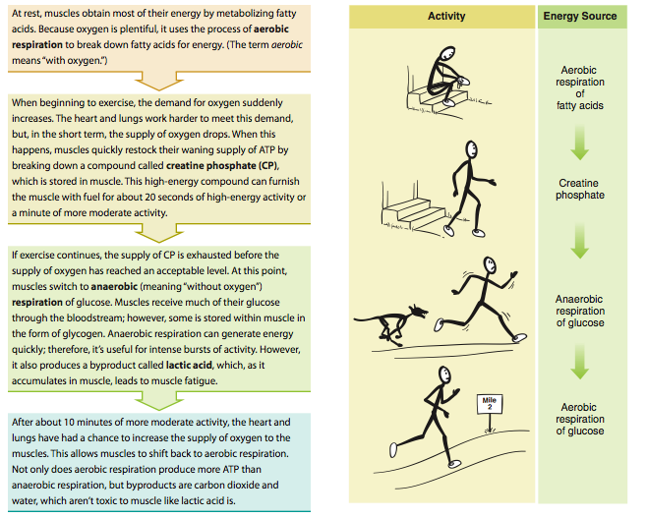

Slide 54
Oxygen Debt
The liver will attempt to convert the lactic acid back into glucose, however, during strenuous activity, more lactic acid is being created than the liver can keep up with
As a result, lactic acid builds up in the muscle tissue
Leads to muscle fatigue
Following strenuous exercise, the liver continues to work to convert the lactic acid into glucose. However the process requires a lot of oxygen. The amount of oxygen required is known as oxygen debt.
Leads to breathing heavily following a hard workout

Slide 55
Muscle Fatigue
When a muscle loses its ability to contract during strenuous exercise, it is referred to as fatigue.
Muscle fatigue usually arises from the accumulation of lactic acid in the muscle.
A lowered pH (low pH = acidic) due to the accumulated lactic acid prevents the muscle from responding to stimulation

Slide 56
Types of Muscle Fibers
Slow Twitch (Type 1) | Fast Twitch (Type 2)
AKA: Red Fibers | AKA: White Fibers
Contract slowly | Contract rapidly
Aerobic (Good oxygen/blood supply) | Anaerobic (Poor oxygen/blood supply)
Exert less force | Exert great force
Contract repeatedly (Resistant to fatigue) | Easily exhausted (Fatigue easily)
Endurance based (Marathon runners) | Speed/Strength based (Weight lifters/Sprinters)

Slide 57
Muscle Fiber Types and Performance
Power Athletes
Sprinters
Have a high % of fast fibers
Endurance Athletes
Distance runners
Have a high % of slow fibers
Others
Nonathletes
50% slow fibers and 50% fast fibers

Slide 58
Types of Muscle Contractions
When skeletal muscles contract, they may produce two types of contractions:
Isotonic Contraction
Isometric Contraction

Slide 59
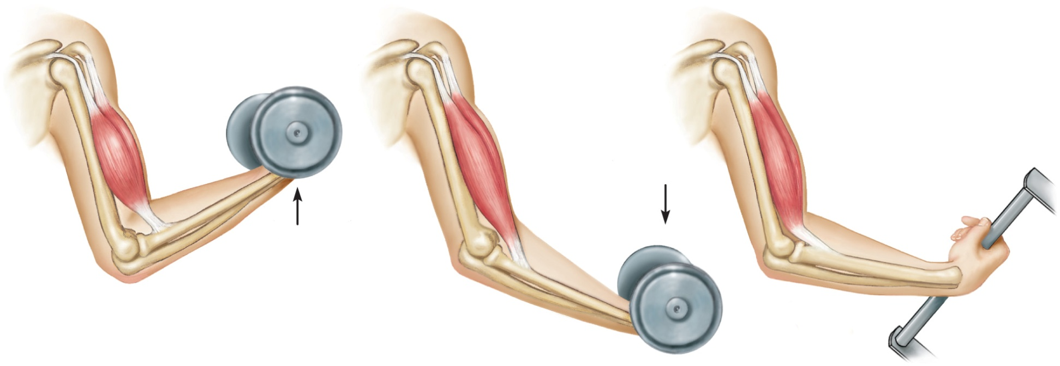
Types of Muscle Contractions
Isotonic Contraction
Length of muscle changes, usually resulting in movement of a joint
The tension (load) on a muscle stays constant during movement
Two Types
Concentric – shortening a contraction
Eccentric – lengthening a contraction
(a) Muscle contracts with
force greater than
resistance and
shortens (concentric
contraction)
Movement
Movement
(b) Muscle contracts
with force less than
resistance and
lengthens (eccentric
contraction)
Notes:
Examples – lifting a baby, picking up an object, walking, etc.

Slide 60
Types of Muscle Contraction
Isometric Contraction
Length of muscle does not change, even as tension increases
Example: holding a baby at arms length, pushing against a closed door
Necessary in everyday life to counteract effects of gravity
Example: postural muscles keeping head up
(c) Muscle contracts but
does not change length
(isometric contraction)
Notes:
T

Slide 61
Muscle Growth and Size
Hypertrophy – enlargement of muscle
Due to strenuous activity
More actin and myosin filaments are formed (NOT muscle fibers!)
Muscle fiber diameter increases in size
Atrophy – decrease in muscle size
With lack of exercise
Loss of actin and myosin filaments
Muscle fiber diameter decrease in size

Slide 62
Muscles Working Together
For muscles to create movement, they can only pull
Muscles in the body rarely work alone & are usually arranged in groups surrounding a joint
A muscle that contracts to perform the desired action is known as an agonist or prime mover
A muscle that helps the agonist is a synergist
A muscle that opposes the action of the agonist, therefore undoing the desired action, is an antagonist

