Slide 2
The brain is weird…
Form a team of three individuals. There will always be a test subject, partner 1 and partner 2. Rotate until each person has been the test subject.
Partner 1 stand still.
Test Subject stand behind Partner 1.
Partner 2 stand behind the Test Subject.
Test subject reach around Partner 1 and touch their nose.
Partner 2 reach around the Test Subject and touch their nose.
Test subject must close their eyes and remain closed throughout the procedure.
Partner 2 begins a gentle, rhythmic tapping.
When Test Subject feels the tapping, they begin tapping on Partner 1 with the same soft rhythm.
Tap for two minutes
Partner 2 stop tapping and then the Test Subject follows.
Test Subject needs to describe, in their data section, the sensations experienced.
Repeat two more times for each Partner to be the Test Subject.

Slide 3
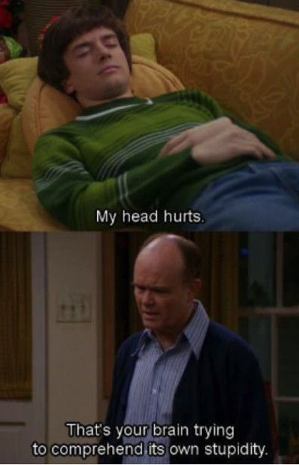
Nervous System

Slide 4
Nervous System
Consists of:
Brain
Spinal cord
Nerves

Slide 5
Functions of the Nervous System
Sensory
Uses sense organs and nerve endings to detect changes inside and outside the body
Integrative
Processes the sensory information received, relates it to past experiences, and determines what response is appropriate
Motor
Issues commands to the muscles and glands to act on the decisions that were made based on the information
Notes:
Integrative Function
Translates sensory information to be used to create:
Sensations
Memory
Thoughts
Decisions

Slide 6
Divisions of the Nervous System
Central Nervous System (CNS)
Brain
Spinal cord
Peripheral Nervous System (PNS)
All the nerves that connect the CNS to the rest of the body
Cranial nerves
Spinal nerves

Slide 7
Divisions of the PNS
Two parts…
Afferent – brings sensory info to CNS
Efferent – takes motor commands from CNS
Think SAME
Efferent is split as well
Somatic – carries information to skeletal muscle
Autonomic – carries information to smooth muscle, cardiac muscle, and glands

Slide 8
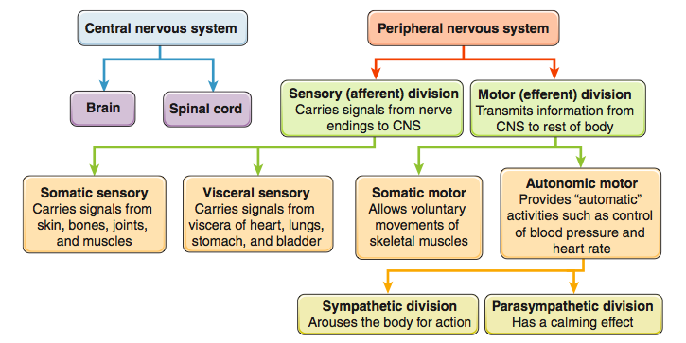
Divisions of the Nervous System

Slide 9
Nervous Tissue
Neurons – nerve cells that are specialized to react to physical and chemical changes in their surroundings
Structural and functional units of the nervous system
Transmit info to other cells in the form of electrochemical changes called nerve impulses
Neuroglial Cells – cells that provide support, insulation, protection, and nutrients for neurons
Notes:
“-glia” – glue… binds neurons together

Slide 10
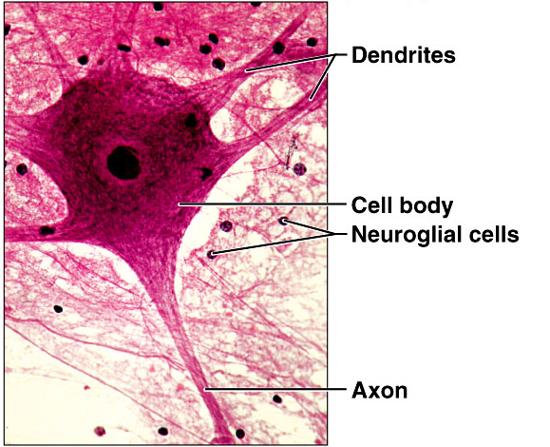

Slide 11
Skip the “Neuroglial Cells” section in your notes – we’ll be coming back to it later! - and turn to the next page to “Types of Neurons”

Slide 12
Types of Neurons - Function
Sensory Neurons
Detect stimuli
touch, pressure, heat, cold, etc.
Transmit the information to the CNS

Slide 13
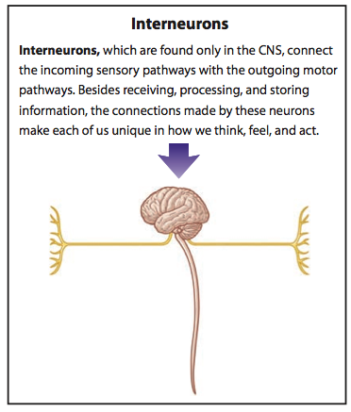
Types of Neurons - Function
Interneurons
Only in CNS
Connect the incoming sensory pathways with the outgoing motor pathways
Notes:
90% of the body’s neurons are interneurons

Slide 14
Types of Neurons - Function
Motor Neurons
Relay messages from the brain to the muscles or glands

Slide 15
Types of Neurons - Structure
Multipolar
Have one axon and multiple dendrites
Most common
Includes most of the neurons of the brain and spinal cord

Slide 16
Types of Neurons - Structure
Bipolar
Have two processes – one axon and one dendrite – with the cell body in between
Found in the retina of the eye and olfactory nerve in the nose

Slide 17
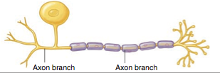
Types of Neurons - Structure
Unipolar
Have one process – an axon – extending from the cell body before branching into a T shape
Mostly located in the sensory nerves of the PNS

Slide 18
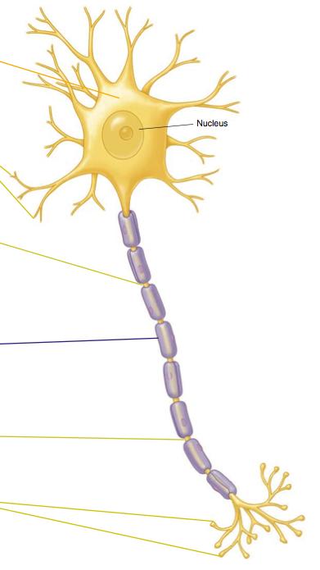
Cell Body – rounded part that is the control center and contains the nucleus
Dendrites – receive signals from other neurons and sends them to
the cell body. Some neurons have only one dendrite, others have thousands.
Axon – carries nerve signals from the cell body. An axon is longer than the dendrites and contains few branches. The length can range from a few millimeters to as much as a meter.
Notes:
The sciatic nerve contains the longest axon in the body – it extends from the base of the spine to the big toe in each foot

Slide 19
Neuron Structure
The axons of many (but not all) neurons are encased in a myelin sheath. Consisting mostly of lipid, myelin acts to insulate the axon.
The Nodes of Ranvier are gaps in the myelin sheath that occur at evenly spaced intervals.

Slide 20
Neuron Structure
Let’s assemble a neuron!

Slide 21
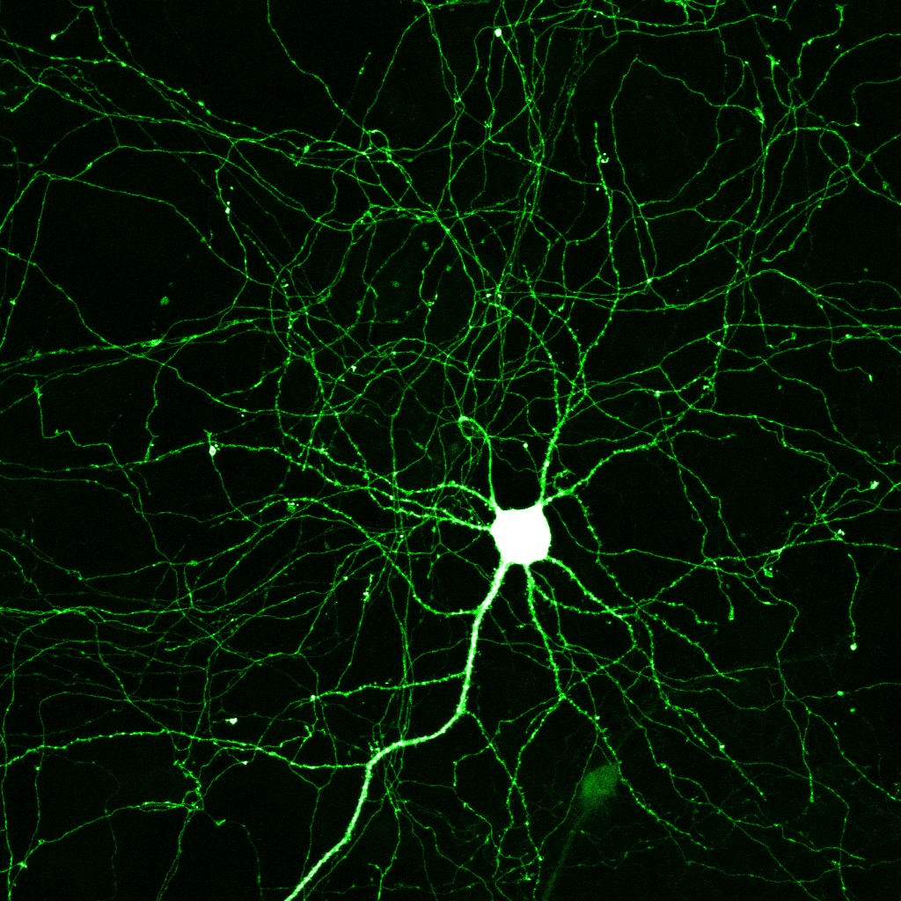

Slide 22
Reading break!
Using the information provided, continue to fill in your notes accordingly.

Slide 23
Types of Neuroglial Cells
Refresh my memory – What are neuroglial cells again?
Neuroglial Cells – cells that provide support, insulation, protection, and nutrients for neurons
There are ~ 50 neuroglial cells for every neuron

Slide 24
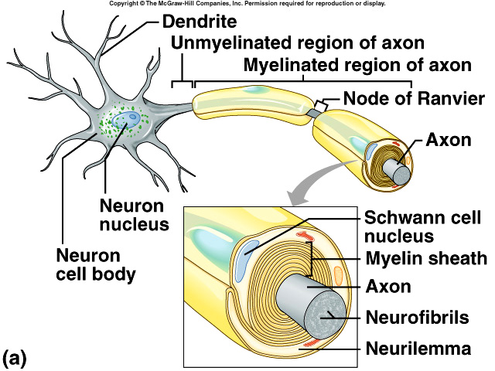
Neuroglial Cells - PNS
Schwann cells
Located in the PNS
Produce myelin sheath around nerves of the PNS

Slide 25
Neuroglial Cells - CNS
Astrocytes
Largest and most numerous
Provide structural support
Extend through brain tissue
Form scar tissue after an injury to the CNS
Oligodendrocytes
Produce myelin sheaths to nerves of the brain and spinal cord

Slide 26
Neuroglial Cells - CNS
Microglial Cells
Least numerous and smallest
Located throughout CNS – brain and spinal cord
Phagocytize bacteria and cellular debris
Ependymal Cells
Located in CNS – brain and spinal cord
Secrete cerebrospinal fluid

Slide 27
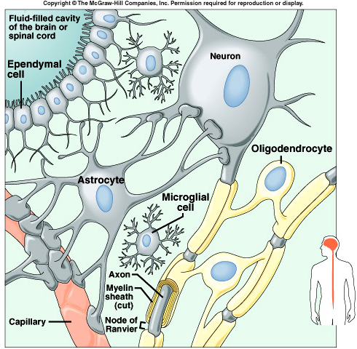

Slide 28
How do nerves transmit messages?

Slide 29
Impulse Conduction
To relay messages throughout the body, nerves must initiate and then transmit signals from one neuron to the next at lightning speed
Signal transmission occurs through an electrical current which results from the flow of charged particles from one point to another

Slide 30
Cell Membrane Potential
Membrane Potential - Whenever ions with opposite electrical charges are separated by a membrane, the potential exists for them to move toward one another
Polarized - A membrane that exhibits membrane potential has an excess of positive ions (K⁺, Na⁺) on one side and an excess of negative ions (PO₄⁻³, SO₄⁻²) on the other side

Slide 31
Resting Potential
Resting Potential
The inside of a neuron is negative relative to the outside
Inside: Has permanent negative ions (phosphate, sulfate) that are too big to get out and high K⁺ concentration
Outside: Has high Na⁺ concentration
(Typo in box below)
Notes:
Because of the cell’s permeability, a certain amount of sodium and potassium ions leak across the membrane. The sodium-potassium pump constantly works to restore the ions to the appropriate side

Slide 32
Depolarization
Stimulation of a membrane can affect its resting potential
Temperature change, Light, Pressure
When a stimulus comes along, Na⁺ ion channels open, causing Na⁺ to rush into the cell.
The membrane potential then becomes less negative and the membrane is depolarized.

Slide 33
Action Potential
If strong depolarization occurs, a threshold potential is achieved and more Na⁺ enters the cell’s interior.
When threshold is reached, an action potential (aka: nerve impulse) is created.
The action potential continues down the axon as one segment stimulates the segment next to it

Slide 34
Repolarization
The sudden increase in Na⁺ triggers the opening of channels to allow K⁺ to flow out of the cell thus repolarizing the cell
Inside = negative charge
Outside = positive charge

Slide 35
Refractory Period
Well crap. Now the Na⁺ and K⁺ are flip-flopped.
The sodium-potassium pump works to return the Na⁺ to the outside and K⁺ to the inside and thus returns the cell to its resting potential

Slide 36
Put the following events in order
Potassium channels open
Sodium ions diffuse inward, depolarizing the membrane
Threshold stimulus is received
Potassium ions diffuse outward, repolarizing the membrane
A wave of action potentials travels the length of the axon as a nerve impulse
Sodium channels open
Neuron is in resting potential

Slide 37
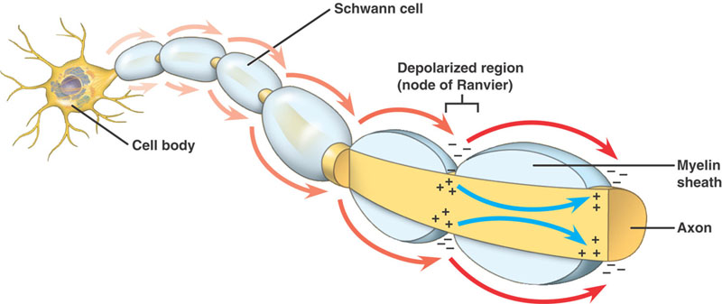
Impulse Conduction
Unmyelinated fibers conduct impulses over their entire membrane surface
Myelinated fibers conduct impulses from Node of Ranvier to Node of Ranvier
The nerve impulse “leap frogs” its way down the neuron
Much much faster!
Notes:
Neurons can transmit impulses up to 268 mph

Slide 38
All-or-None Response
All-or-None Response - If a neuron responds at all, it responds completely
If the threshold isn’t reached, the neuron doesn’t fire
All impulses carried on an axon are the same strength.
A stronger impulse doesn’t produce a stronger response

Slide 39
Communication Between Neurons
Nerve impulses usually travel through several different neurons before reaching their target organ or tissue.
Thus, neurons must have some way of transferring the impulse from one neuron to the next.

Slide 40
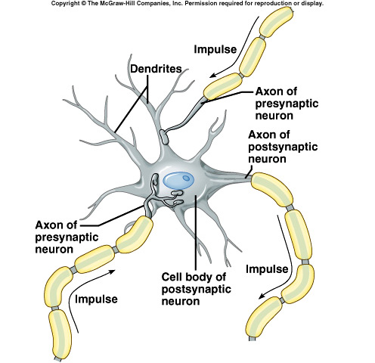
The Synapse
Synapse – where two neurons meet
Synaptic cleft – small gap between two neurons
Presynaptic neuron – neuron sending the impulse
Postsynaptic neuron – neuron receiving the impulse

Slide 41
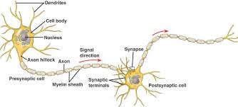

Slide 42
Synaptic Transmission
Nerve impulse crosses the synaptic cleft to reach the postsynaptic neuron using neurotransmitters (NT)
NT are stored in the synaptic vesicles
Neurotransmitters bind to receptors on the postsynaptic neuron and allows the impulse to continue

Slide 43
http://media.hhmi.org/biointeractive/click/Neuron_Activity/01-vid.html

Slide 44
Types of Neurotransmitters
Excitatory – turning a process on
Acetylcholine
Involved in muscle contraction
Norepinephrine
Involved in mood
Creates a sense of feeling good
Inhibitory – turning a process off
Serotonin
Involved in mood, emotions, sleep
Low serotonin can cause depression or anxiety
Antidepressants and antianxiety RXs make more NTs available to the brain

Slide 45
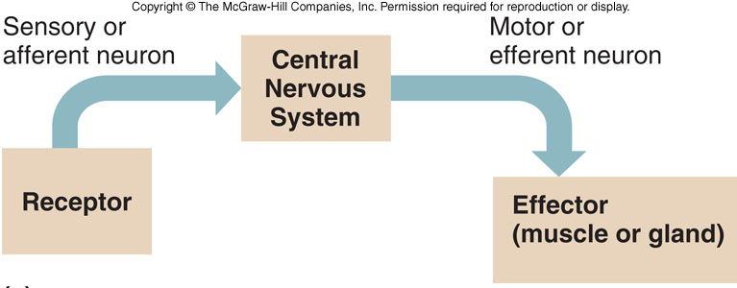
Nerve Pathways
The routes nerve impulses travel are called nerve pathways, the simplest of which is a reflex arc.
Reflex Arcs
Includes a
sensory receptor
sensory neuron
reflex center (interneurons) in the spinal cord
motor neuron
effector
Notes:
*Add in drawing on their notes *Reflex arc bypasses regions of the brain where conscious decisions are made, which is why someone becomes aware of a reflex only after it’s occurred

Slide 46
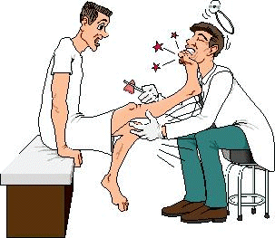
Reflexes
Reflexes – automatic, subconscious responses to stimuli within or outside the body
Involves a Stimulus & Response
Maintain homeostasis
Autonomic Reflexes - Carry out automatic responses (vomiting, sneezing, swallowing, etc.)
Somatic Reflexes – involve the contraction of skeletal muscle

Slide 47
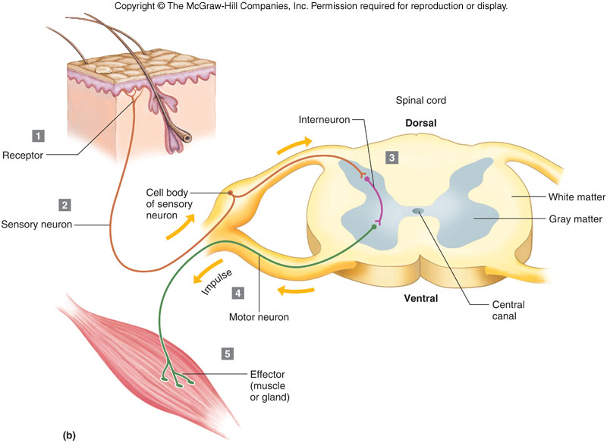
General Components of a Spinal Reflex

Slide 48
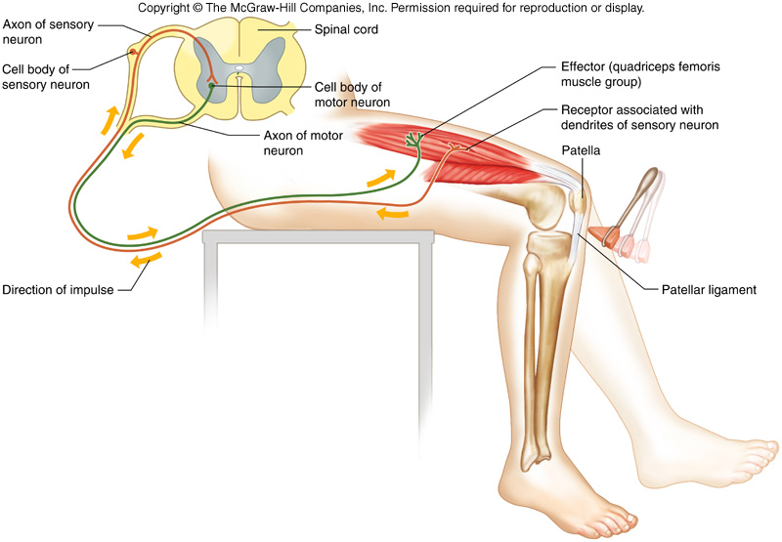
Types of Reflexes - Somatic
Knee-jerk reflex
Simple reflex (no interneuron)
Helps maintain an upright posture

Slide 49
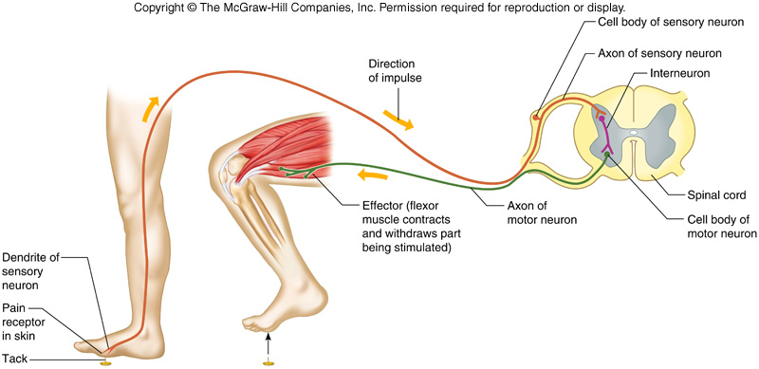
Types of Reflexes - Somatic
Withdrawal Reflex
Involves sensory neurons, interneurons, and motor neurons
Prevents or limits tissue damage

Slide 50
Types of Reflexes - Autonomic
Stimulus | Response
The smell of your favorite food | Salivation
A nasty odor | Nausea
A bright light shining in your eye | Pupils get smaller
An insect flying towards your eye | Blinking

Slide 51
Central Nervous System

Slide 52
Protective Covering
Outer coverings:
Brain – Skull
Spinal Cord – Vertebral column
Inner coverings:
Brain and Spinal Cord – Meninges
Dura mater
Arachnoid mater
Pia mater

Slide 53
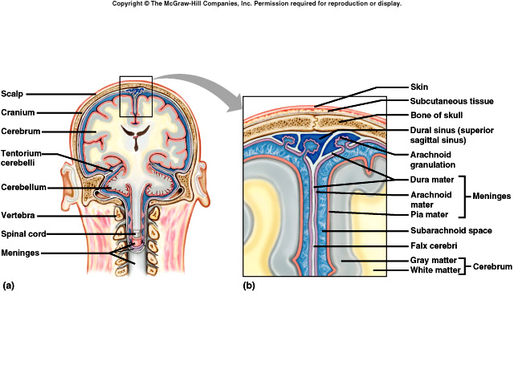
Meninges
Pia mater
Innermost layer
Very thin, transparent tissue
Subarachnoid space
Between arachnoid mater and pia mater
Contains cerebrospinal fluid (CSF)
Meninges – layered membranes between the bones and soft tissue of the CNS that offer protection
Dura mater
Outermost layer
White, fibrous tissue
Arachnoid mater
Middle layer
Delicate, thin tissue
“Cobwebby”

Slide 54
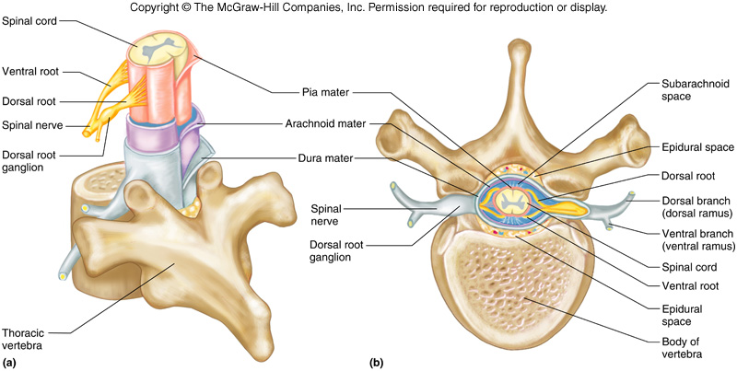

Slide 55
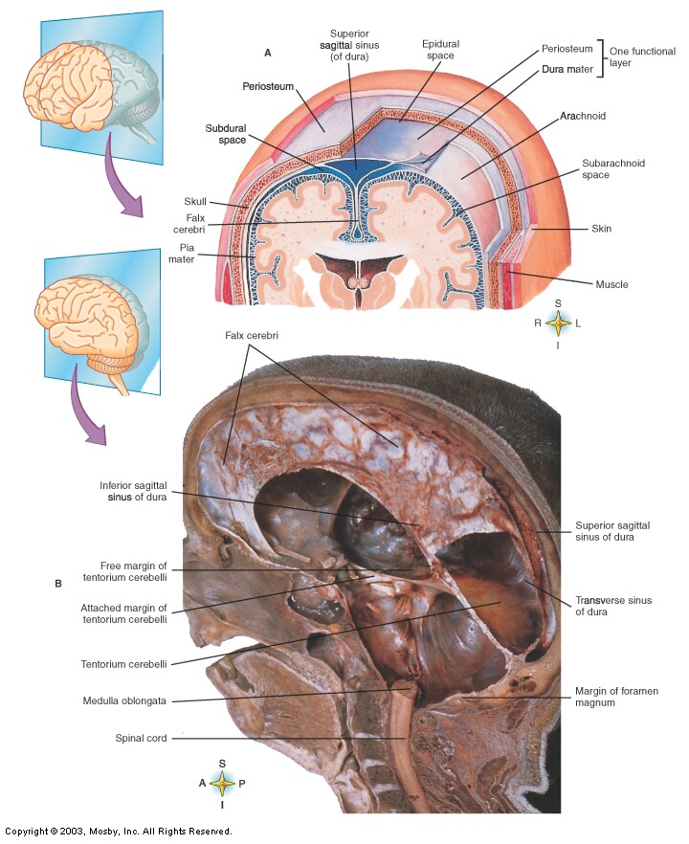

Slide 56
Meningitis
Infection/swelling of meninges
Caused by infection with viruses, bacteria, or other microorganisms
Potentially life threatening due to the inflammation's proximity to the brain and spinal cord; it is therefore a medical emergency
Symptoms
headache and neck stiffness
Fever, confusion or altered consciousness
inability to tolerate light (photophobia) or loud noises (phonophobia).
Diagnosed by spinal tap (not the band)
Must be treated promptly with antibiotics and sometimes antiviral drugs
Can lead to serious long-term consequences such as deafness, epilepsy, hydrocephalus and cognitive deficit, especially if not treated quickly.
Some forms of meningitis may be prevented by immunization

Slide 57
Spinal Cord

Slide 58
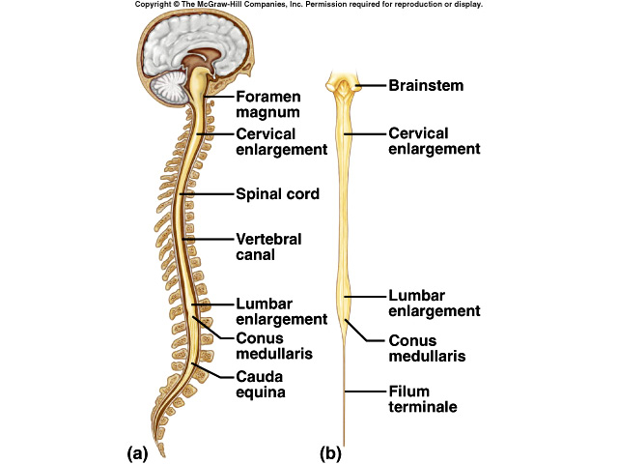
Spinal Cord
Located in the spinal cavity of the vertebral column (duh…)
Extends from foramen magnum (where’s that?) to beginning of lumbar vertebrae
As wide as your finger and extends for about 17”

Slide 59
Spinal Cord
31 Segments
Each segment has a pair of spinal nerves that connect the CNS to the rest of the body
Cervical enlargement
Nerves to upper limbs
Lumbar enlargement
Nerves to lower limbs

Slide 60
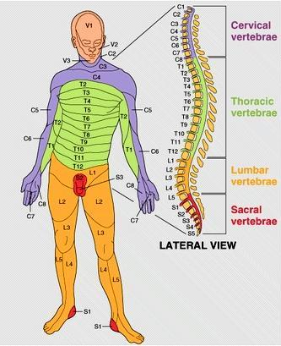

Slide 61
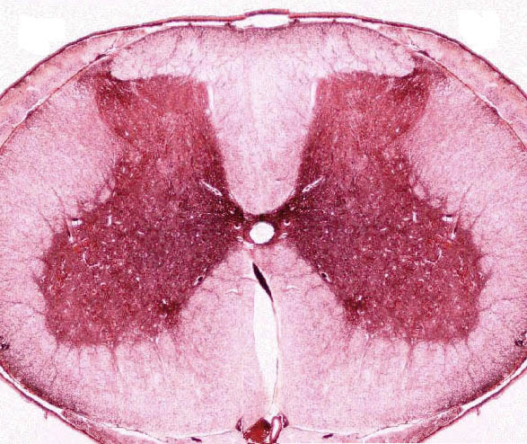
Spinal Cord
Gray Matter
Mostly interneurons
Extends length of spinal cord
Spinal reflex centers
White Matter
Surrounds gray matter
Composed of major nerve pathways called nerve tracts that carry nerve impulses through the nervous system
Central Canal
Carries cerebrospinal fluid (CSF) through the spinal cord

Slide 62
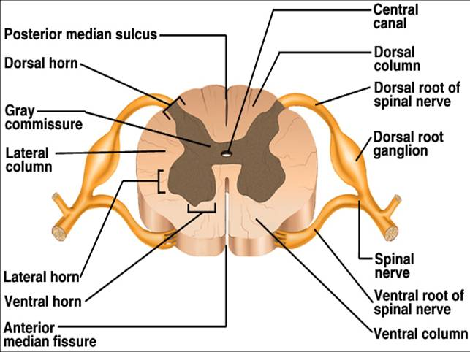
Cross Section of Spinal Cord
Spinal Nerves
Dorsal root – Sensory impulses
Ventral root – Motor impulses

Slide 63
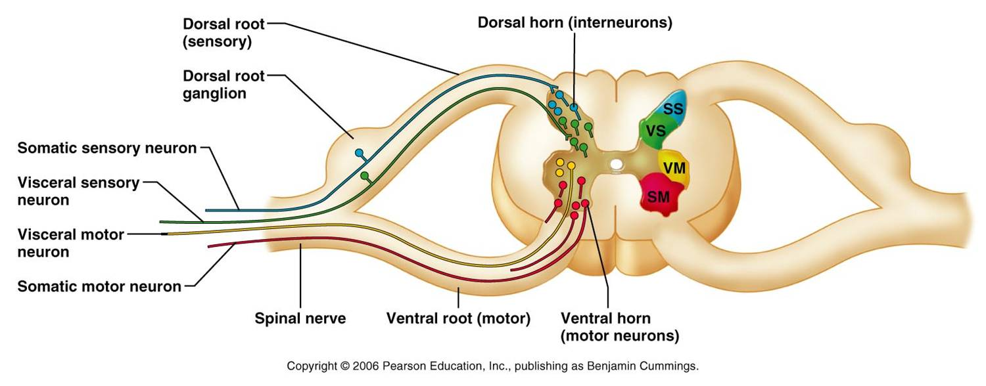
Cross Section of Spinal Cord

Slide 64
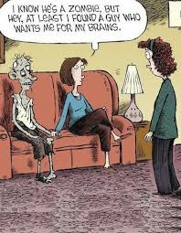
Brain
Notes:
Fast Fact: The brain constitutes only 2% of an adult’s body weight but it receives 15% of the blood and consumes 20% of the body’s oxygen and glucose

Slide 65
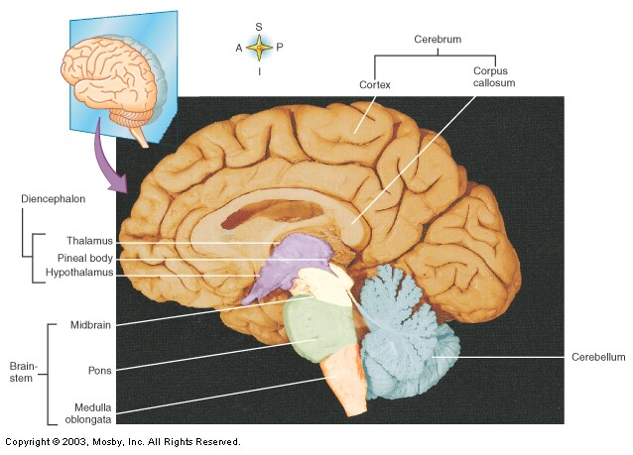
Brain
Major parts:
Brainstem
Medulla oblongata
Pons
Midbrain
Cerebellum
Diancephalon
Cerebrum
Right hemisphere
Left hemisphere

Slide 66
Functions of the Brain
Interprets sensations
Coordinates muscular movements
Regulates visceral activities
Determines personality
Determines perception
Stores memory
Reasoning
Makes decisions

Slide 67
Brain stem
Connects cerebrum to spinal cord
Consists of 3 parts
Medulla oblongata
Pons
Midbrain

Slide 68
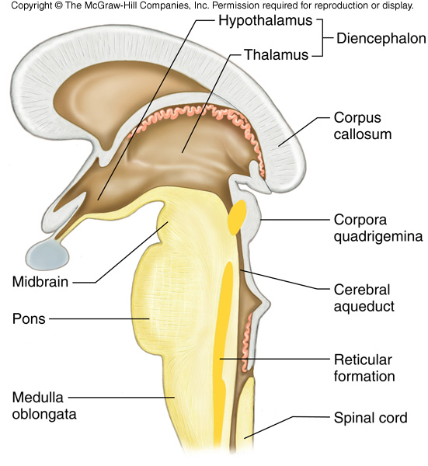
Brain Stem
Medulla oblongata
Lowest part of the brainstem
Attaches brain to spinal cord just above foramen magnum
Contains:
Cardiac center – controls heart rate
Respiratory center – regulates the rate, rhythm, and depth of breathing
Vasomotor center – controls blood pressure
Notes:
Injury often causes death

Slide 69
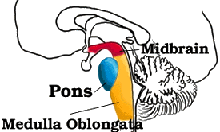
Brain Stem
Pons
Located between medulla oblongata and midbrain
Helps regulate rate and depth of breathing

Slide 70
Brain Stem
Midbrain
Located superior to pons, inferior to the cerebrum/diencephalon
Contains centers for visual and auditory reflexes

Slide 71
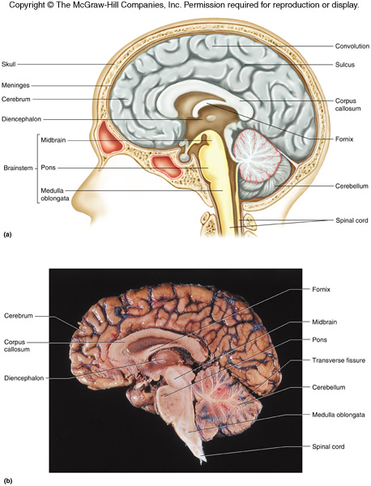
Cerebellum
Located inferior to occipital lobe
Functions:
Integrates sensory information concerning position of body parts, coordination, and posture
Stores the information necessary for muscle groups to work together and perform smooth movements
Notes:
People with cerebellar dysfunction (such as from a tumor, hemorrhage, or trauma) have a spastic gait, poor balance, jerky movements, and tremors. They also tend to have poor impulse control and overreact emotionally

Slide 72
Diencephalon
Located between cerebrum and midbrain
2 major parts:
Thalamus
Hypothalamus

Slide 73
Diencephalon
Thalamus
Gateway for sensory impulses heading to cerebral cortex
Receives all sensory impulses (except smell)
Conscious recognition of pain, temperature, touch
Emotions of pleasant and unpleasant
Hypothalamus
Maintains homeostasis by regulating visceral activities
Heart rate
Blood pressure
Body temperature
Water and electrolyte balance
Regulates appetite
Sleep and wakefulness

Slide 74
Label the following parts of the brain
5.
4.
1.
3.
2.

Slide 75
Cerebrum
Structure
Corpus callosum
Connects right and left cerebral hemispheres
Gyri (convolutions)
Bumps
Sulci
Grooves
Longitudinal fissure
Separates hemispheres
Transverse fissure
Separates cerebrum from cerebellum
Functions
Consciousness
Language
Emotions
Memory

Slide 76
Interactive Brain Map

Slide 77
Lobes of Cerebral Hemispheres
Frontal – Anterior portion of each hemisphere
Parietal – Posterior to the frontal lobe
Temporal – Inferior to the frontal and parietal lobes
Occipital – Posterior portion of each hemisphere

Slide 78
Frontal Lobe
Structure | Location | Function
Frontal Lobe | Anterior part of right and left hemisphere of the cerebrum | Personality (pre-frontal) Speech (Broca’s area) Problem solving Critical thinking Planning Judgment Impulse control
Notes:
Frontal lobe – last to develop and first to deteriorate

Slide 79
Parietal Lobe
Structure | Location | Function
Parietal Lobe | Posterior to the Frontal Lobe, on the superior part of the brain | Primary sensory area (touch, tempearture, pressure, pain) Body position (proprioception) Numbers and math Visuospatial processing (reading maps) Understanding speech

Slide 80
Temporal Lobe
Structure | Location | Function
Temporal Lobe | Inferior to Frontal and Parietal Lobes | Memory – long and short-term Auditory (Hearing) Understanding language (written and spoken) Processing emotions
Notes:
Long-term memory = reading (remembering the alphabet), your house, what your mom looks like, etc.

Slide 81
Occipital Lobe
Structure | Location | Function
Occipital Lobe | Posterior portion of right and left hemispheres of the cerebrum | Visual processing Imagination “Visualize yourself performing a task in order to do the task better in real life”
Notes:
Sense motion, differentiate colors, spatial processing – if one lobe becomes damaged, could result in partial blindness, total blindness, difficulty differentiating colors, and even hallucinations

Slide 82
Frontal Lobe
Structure | Location | Function
Broca’s Area | Frontal Lobe | Speech production Speech-associated gestures
Prefrontal Cortex | Frontal Lobe | Personality How you behave in social settings Organizes thought and actions to meet goals Impulse control

Slide 83
Frontal Lobe
Structure | Location | Function
Motor Cortex | Frontal Lobe | Fine motor skills, especially of the muscles of the hands and facial expression

Slide 84
Parietal Lobe
Structure | Location | Function
Sensory Cortex | Parietal Lobe | Interprets information from all 5 senses

Slide 85
Temporal Lobe
Structure | Location | Function
Auditory Cortex | Temporal Lobe | Differentiate between voices, sounds, and background noise

Slide 86
Occipital Lobe
Structure | Location | Function
Visual Cortex | Occipital Lobe | Differentiate colors Distinguish between complex things such as faces

Slide 87
Hemisphere Dominance
Left Hemisphere
Right Hemisphere
Motor control of right side of body
Language
Reasoning
Analytical thought
Science and math
Motor control of left side of body
“Big Picture”
Creativity
Emotion
Imagination
Art and music
The left hemisphere is dominant in most individuals, however, in some individuals, the right hemisphere might be dominant or equal to the left.

Slide 88
Peripheral Nervous System

Slide 89
Peripheral Nervous System
Consists of nerves that branch out from the CNS and connect it to other body parts
Somatic – Voluntary/Conscious
Autonomic – Involuntary/Unconscious
Parasympathetic
Sympathetic
Includes:
Cranial Nerves – arise from the brain
Spinal Nerves – arise from the spinal cord

Slide 90
Somatic Nervous System
Cranial and spinal nerves that connect to skin and skeletal muscles
Conscious activities

Slide 91
Autonomic Nervous System
Nerve fibers that connect CNS to viscera (heart, stomach, intestines, glands)
Unconscious activities
Two divisions
Sympathetic – prepares body for fight or flight situations
Parasympathetic – prepares body for resting and digesting

Slide 92
Examples…
Sympathetic
Dilates pupil
Increases heart rate
Moves blood to skeletal muscles
Parasympathetic
Constricts pupil
Decreases heart rate
Moves blood to digestive, less to skeletal

Slide 93
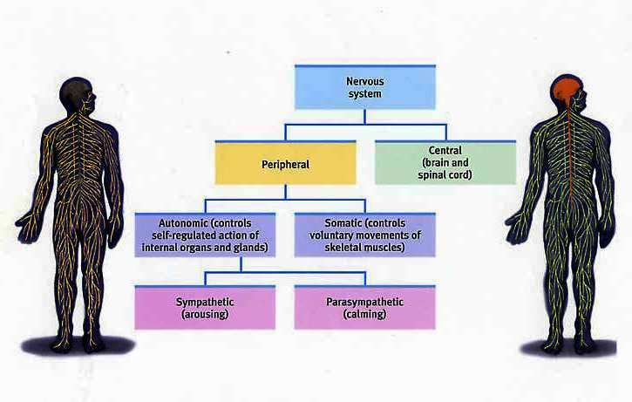

Slide 94
Nerve Fiber Classification
Remember – SAME!
Sensory (afferent) Nerves – conduct impulses into brain or spinal cord
Motor (efferent) Nerves – conduct impulses to muscles or glands
Mixed Nerves – contain both sensory nerve fibers and motor nerve fibers
Most nerves

Slide 95
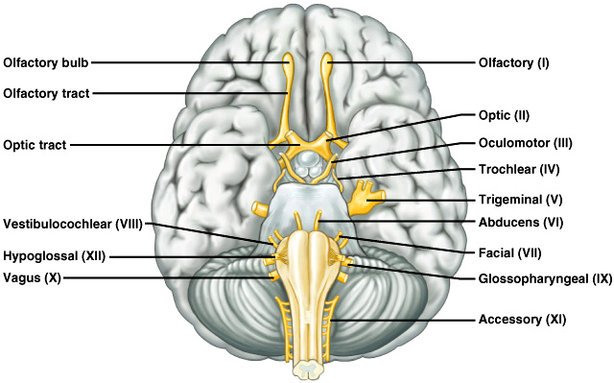
Cranial Nerves

Slide 96
Cranial Nerves
Name | Number | Sensory/Motor/Mixed | Function
Olfactory | 1 (I) | Sensory | Sense of Smell
Optic | 2 (II) | Sensory | Sense of Vision
Oculomotor | 3 (III) | Motor | Raises eyelids Eye movement Controls the amount of light (pupil constriction/dilation)
Trochlear | 4 (IV) | Motor | Eye movement
Trigeminal | 5 (V) | Mixed | Sensory: Touch sensation from eyes, cheeks, scalp, mouth Motor: Muscles of mastication (chewing)
Abducens | 6 (VI) | Motor | Eye movement

Slide 97
Name | Number | Sensory/Motor/Mixed | Function
Facial | 7 (VII) | Mixed | Sensory: Sense of Taste Motor: Muscles of Facial Expression, Tear and saliva production
Vestibulocochlear | 8 (VIII) | Sensory | Sense of Equilibrium and Balance
Glossopharyngeal | 9 (IX) | Mixed | Sensory: Impulses from pharynx and tongue Motor: Muscles of swallowing
Vagus | 10 (X) | Mixed | Sensory: Impulses from pharynx, larynx, esophagus Motor: Muscles of speech and swallowing, Muscles of chest and abdomen viscera
Accessory | 11 (XI) | Motor | Soft palate – Gag Reflex Muscles of SCM and Trapezius – Shrug shoulders
Hypoglossal | 12 (XII) | Motor | Muscles that move the Tongue for speech, swallowing, chewing

Slide 98
Cranial Nerves
On – Olfactory (I)
Occasion – Optic (II)
Our – Oculomotor (III)
Trusty – Trochlear (IV)
Truck – Trigeminal (V)
Acts – Abducens (VI)
Funny – Facial (VII)
Very – Vestibulocochlear (VIII)
Good – Glossopharyngeal (IX)
Vehicle – Vagus (X)
Any – Accessory (XI)
How – Hypoglossal (XII)
Old – Olfactory (I)
Opie – Optic (II)
Occasionally – Oculomotor (III)
Tries – Trochlear (IV)
Trigonometry – Trigeminal (V)
And – Abducens (VI)
Feels – Facial (VII)
Very – Vestibulocochlear (VIII)
Gloomy – Glossopharyngeal (IX)
Vague – Vagus (X)
And – Accessory (XI)
Hyperactive – Hypoglossal (XII)

Slide 99
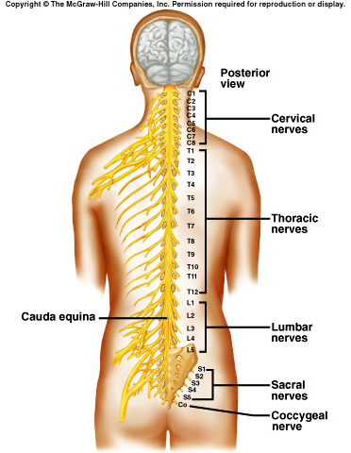
Spinal Nerves
Mixed nerves
31 pairs
8 cervical nerves
12 thoracic nerves
5 lumbar nerves
5 sacral nerves
1 coccygeal nerve

Slide 100
Spinal Nerves

Slide 101
Plexuses
Nerve plexuses – complex networks formed from spinal nerves
Cervical Plexus
Lies deep in the neck
Supply muscles and skin of the neck

Slide 102
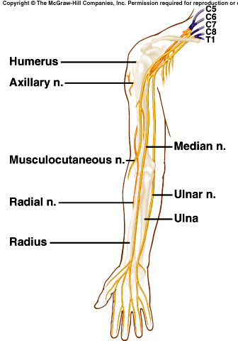
Plexuses
Brachial Plexuses
Spinal nerves of C5-T11
Lies deep within shoulders
Nerves:
Musculocutaneous nerve
Ulnar nerve
Median nerve
Radial nerve
Axillary nerve
Notes:
Axillary nerve – passes close tot eh armpit and therefore is susceptible to damage from the use of crutches

Slide 103
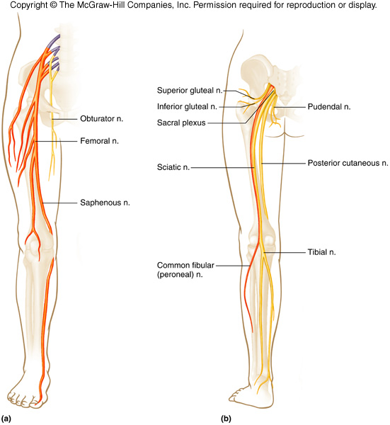
Plexuses
Lumbosacral Plexuses
Spinal nerves of T12-S5
Extend from lumbar region into pelvic cavity
Nerves:
Obturator
Femoral
Sciatic

Slide 104
Lifespan Changes
Brain cells begin to die before birth
Over average lifetime – brain shrinks 10%
Most cell death occurs in temporal lobe
(What does the temporal lobe do?)
By age 90, frontal cortex has lost half its neurons
Decreased level of NTs
Slowed responses and reflexes
Increased risk of falling
Changes in sleep patterns that result in fewer sleeping hours

Slide 105
Cerebral Injuries and Abnormalities
Concussion
TBI – Traumatic Brain Injury
Not “getting your bell rung”
Brain is slammed into skull
Temporary loss of memory
Short-term vs. long-term
Mental cloudiness
Headache
Loss of consciousness vs. no loss of consciousness
Second Impact Syndrome

Slide 106
Coup/Contrecoup

Slide 107
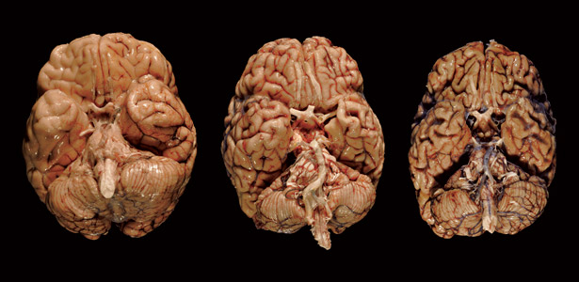

Slide 108
Cerebral Injuries and Abnormalities
Cerebral Palsy
Motor impairment at birth
Caused by blocked cerebral blood vessels during development
Seizures
Learning disabilities
Cerebrovascular
Stroke
Sudden interruption of blood flow
Brain tissue dies

Slide 109
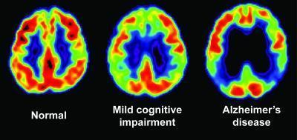
Positron Emmission Tomography (PET) Scan

