Slide 1
The muscular system
“You got tickets…?”

Slide 2
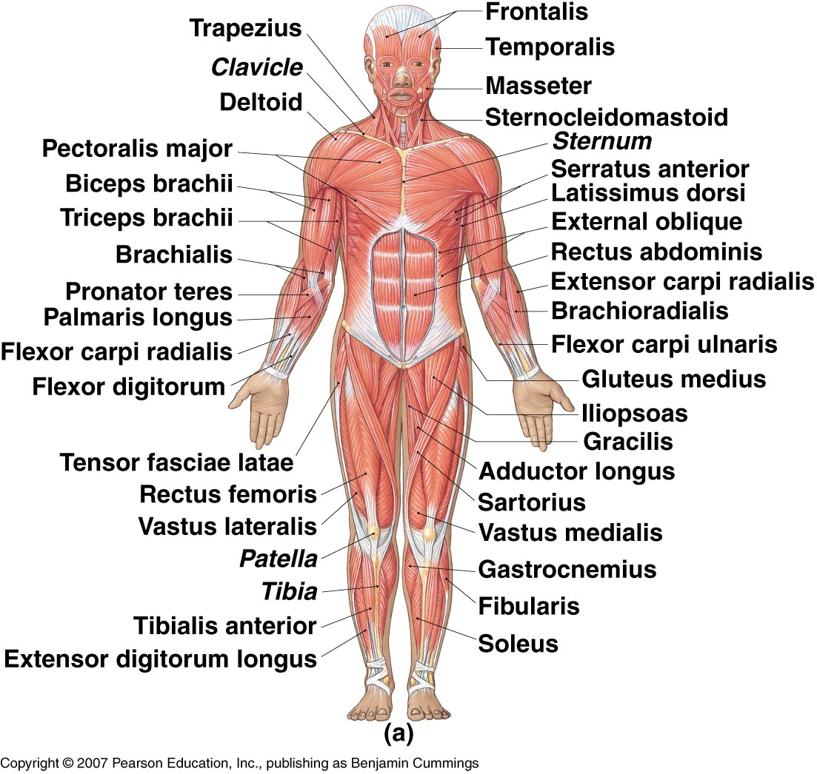

Slide 3
Naming Muscles
Location – structure near which the muscle is found
Frontalis | Frontal bone
Femoris | Femur
Gluteus | Posterior of hip/thigh
Oculi | Eye
Oris | Mouth
Radialis | Radius
Ulnaris | Ulna
Brachialis | Arm

Slide 4
Naming Muscles
Function – body movement when the muscle is contracted
Abductor | Moves part away from body
Adductor | Moves part toward body
Depressor | Lowers a part
Extensor | Extends a part
Flexor | Flexes a part
Levator | Elevates a part
Rotator | Rotates a part

Slide 5
Naming Muscles
Shape – relative shape of the muscle
Deltoid | Shaped like delta ∆
Orbicularis | Circular
Serratus | Saw-toothed
Quadratus | Square
Rhomboideus | Diamond-shaped
Trapezius | Trapezoidal

Slide 6
Naming Muscles
Size – relative size of the muscle
Brevis | Short
Longus | Long
Magnus | Large
Maximus | Largest
Medius | Moderately sized
Minimus | Smaller

Slide 7
Naming Muscles
Fiber direction – relative to the midline
Oblique | Diagonal to midline
Rectus | Parallel to midline
Sphincter | Circling an opening
Transversus | Right angle to midline

Slide 8
Naming Muscles
Number of heads/origins
Bicep | Two heads
Tricep | Three heads
Quadricep | Four heads

Slide 9
Naming Muscles
Muscle names can be
any combination of the
options listed!

Slide 10
Practice
How are the following muscles named?
Biceps femoris
Flexor carpi ulnaris
Gluteus maximus
Abductor magnus
Rhomboid major

Slide 11
Answers
How are the following muscles named?
Biceps femoris - # of heads and location
Flexor carpi ulnaris – action and location
Gluteus maximus – location and size
Abductor magnus – action and size
Rhomboid major – shape and size

Slide 12
Functions of the Muscular System
“Transform energy into motion”
i.e. Produce movement! Of all types!
Examples:
Speaking
Facial expression
Propel blood through blood vessels
Bring air into and out of lungs
Digest food
Produce body heat

Slide 13
Muscular System
Muscles are responsible for all types of body movement
3 basic muscle types are found in the body
Skeletal muscle
Smooth muscle
Cardiac

Slide 14
Cardiac Muscle
Makes up the myocardium of the heart
Involuntarily (unconsciously) controlled
Microscopically the tissue appears striated
Cells are short, branching, and have a single nucleus
Cells connect to each other at intercalated discs

Slide 15
Smooth Muscle
Makes up the walls of organs and blood vessels
Involuntarily (unconsciously) controlled
Microscopically the tissue appears non-striated
Cells are short, spindle-shaped, and have a single nucleus
Tissue is extremely extensible while still retaining its ability to contract

Slide 16
Skeletal Muscle
Attached to the skeleton
Voluntarily (consciously) controlled
Microscopically the tissue appears striated
Cells are long, cylindrical, & multi-nucleated

Slide 17
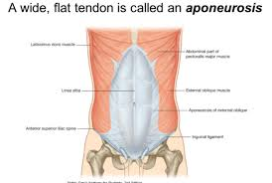
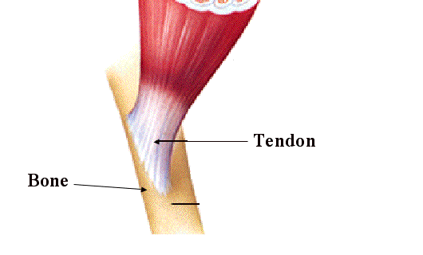
Muscle Attachment
Sites of muscle attachment
Bones
Cartilage
Connective tissue coverings
Muscle fibers blend into a connective tissue attachment
Tendon – cordlike structure that attaches the muscle to bone
Aponeurosis – sheet-like structure

Slide 18
Characteristics of Muscle Tissue
Excitability - can receive and respond to stimulation
Contractility - can shorten to exert a pull
Extensibility - can lengthen
Elasticity - returns to original length after contraction

Slide 19
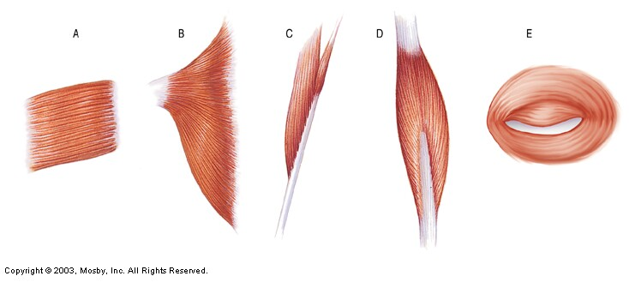
Muscle Fiber Arrangement
Parallel
Convergent
Pennate
Bipennate
Sphincter

Slide 20
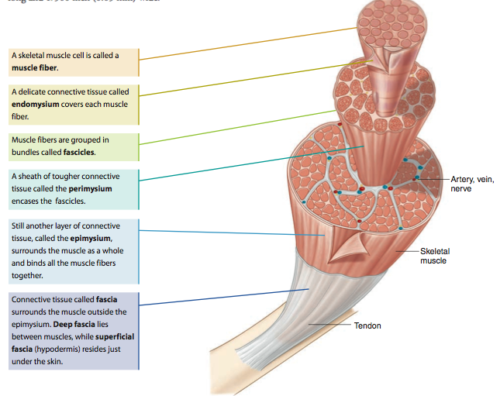
Muscle Fiber – individual muscle cell
Endomysium – connective tissue that surrounds each muscle fiber
Fascicle – group of muscle fibers
Perimysium – connective tissue that surrounds each fascicle
Epimysium – connective tissue that surrounds entire skeletal muscle
Fascia – connective tissue that surrounds entire skeletal muscle (over the epimysium) and eventually forms the tendon

Slide 21
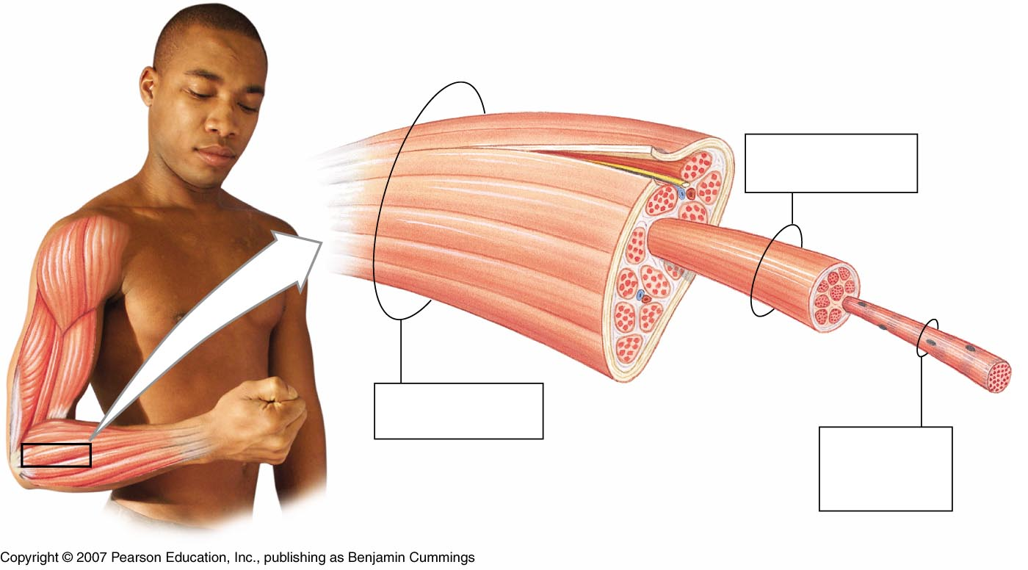
Structure of Skeletal Muscle
epimysium
tendon
perimysium
Muscle Fascicle
Surrounded by perimysium
Skeletal muscle
endomysium
Surrounded by epimysium
Skeletal muscle fiber (cell)
Surrounded by endomysium

Slide 22
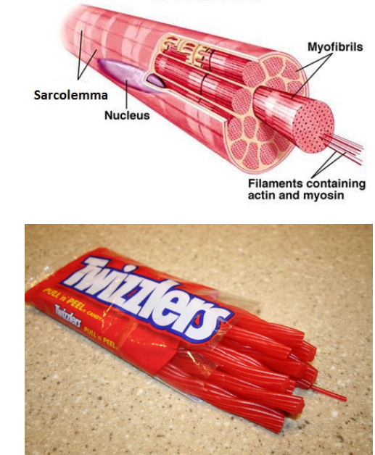

Slide 23
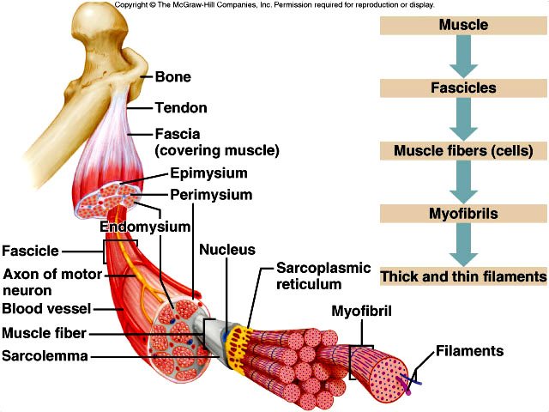

Slide 24
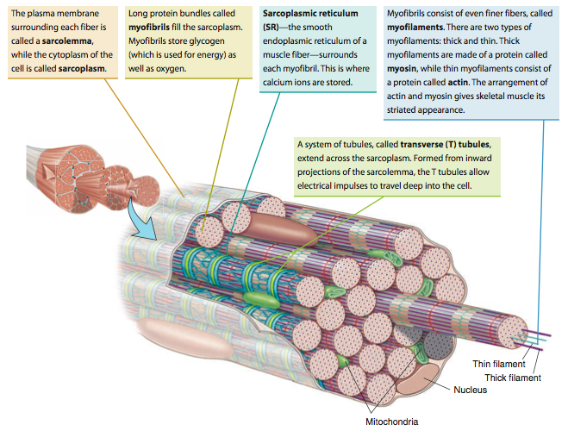
Myofibrils – long protein bundles, store glycogen and O2
Sarcolemma – cell membrane Sarcoplasm - cytoplasm
Sarcoplasmic Retiuclum – smooth ER, surrounds each myofibril, stores Ca⁺²
Myofilaments – Thick and thin filaments that make up a myofibril
T-tubules – allow electrical impulses to travel into cell
Actin Thin
filament
Myosin Thick
filament

Slide 25
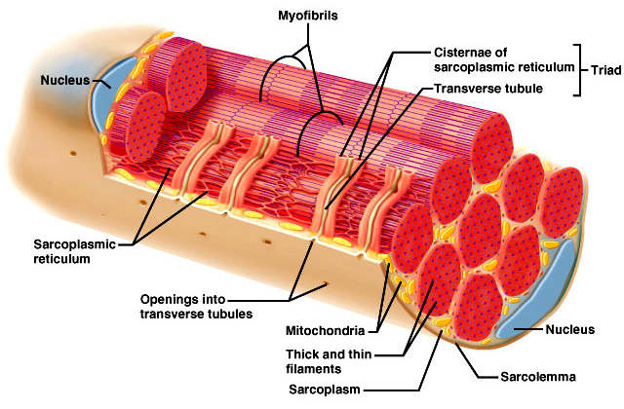

Slide 26
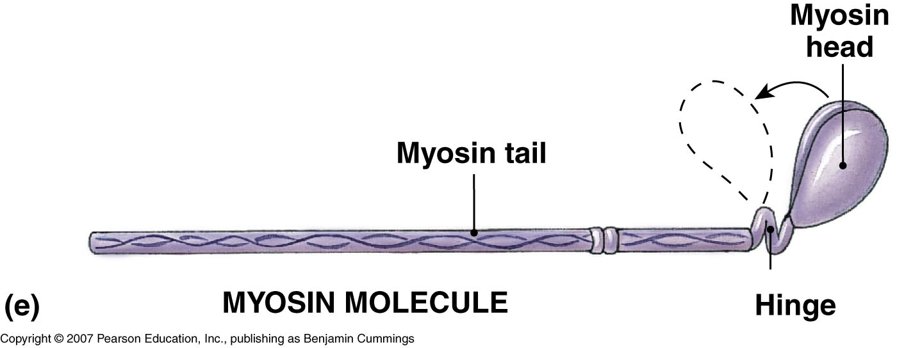
Skeletal Muscle Contraction
Role of Myosin and Actin
Myosin consists of two twisted strands with cross-bridges projecting outward

Slide 27
Skeletal Muscle Contraction
Role of Myosin and Actin
Actin is a protein with binding sites that the myosin cross-bridges attach to
Contains 2 proteins – troponin and tropomyosin

Slide 28
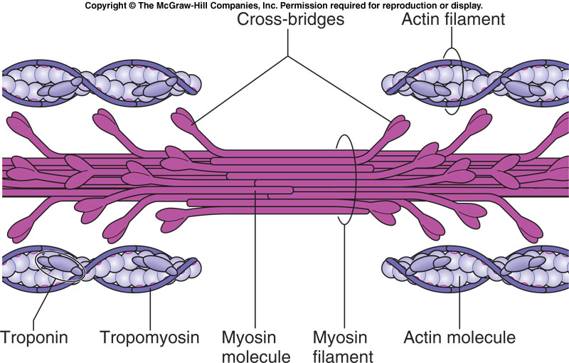
Skeletal Muscle Contraction

Slide 29
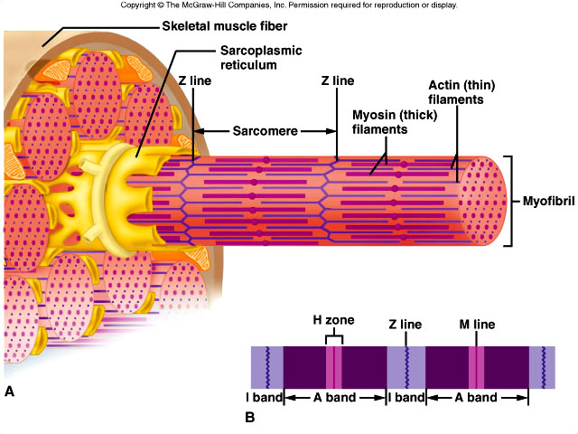
Skeletal Muscle Fibers
The sarcoplasm of each muscle fiber/muscle cell contains myofibrils (rod-like units of muscle)
Myofibrils are separated into compartments called sarcomeres that contain thick filaments and thin filaments
Thick filaments – made of protein called myosin
Thin filaments – made of protein called actin
The organization of these thick and thin filaments produces striations.

Slide 30
Skeletal Muscle Fibers
A sarcomere extends from Z line to Z line
I bands (light bands) are anchored to the Z lines and are length of actin filaments
A bands (dark bands) are the length of myosin filaments

Slide 31
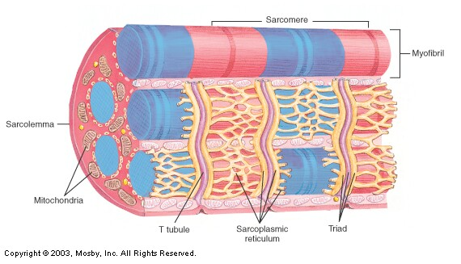
Z line
Z line
I band
A band
Length of myosin heads (wide, dark stripes)
Length of actin (thin, light stripes)

Slide 32
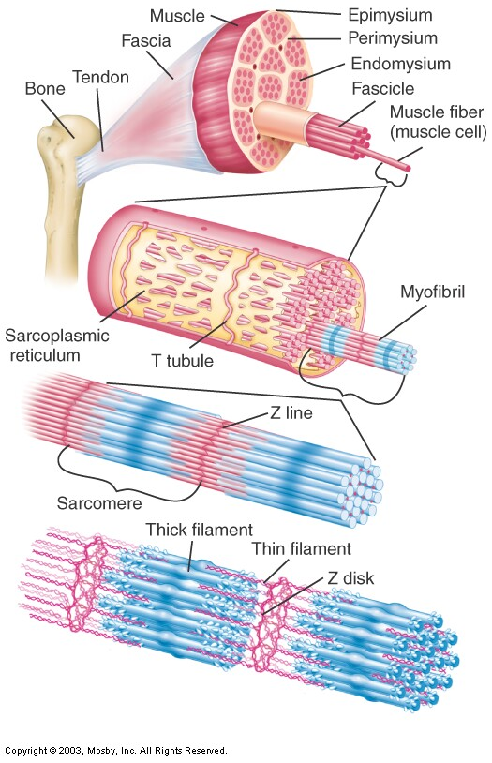

Slide 33
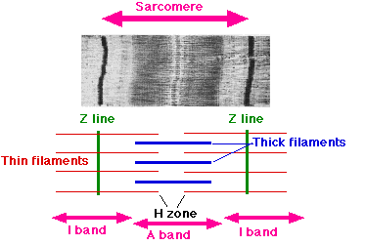

Slide 34
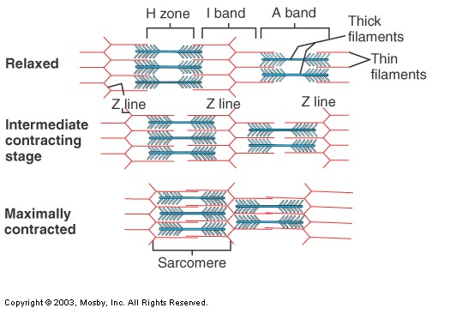

Slide 35
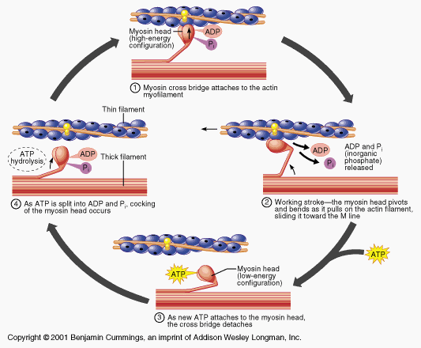
Sliding Filament Theory

Slide 36
Sliding Filament Theory
Myosin heads attach to actin molecules at a binding site
Cross-bridge bends and pulls actin, causing the actin filament to slide across the myosin, toward the center of the sarcomere, causing it to shorten (Z lines move closer together).
Myosin releases… attaches to new binding site and pulls again
Energy is provided from the conversion of ATP to ADP
Releases a ton of energy!!
Energy is needed to properly position myosin cross-bridge so that it can bind with actin
Cycle of “grab and release, grab and release” will continue as long as ATP is available

Slide 37
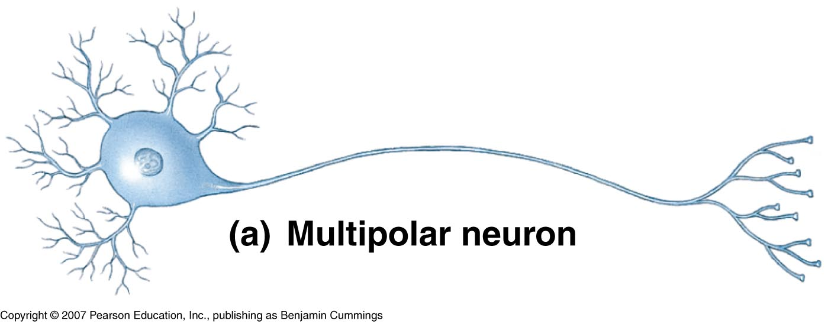
Neuromuscular Junction
Motor neurons – the cells that cause muscle fibers to contract
What type of cells are these? What do they look like?
Root word “Neuro”?
The axon of the motor neuron extends outward from the brain or spinal cord. The muscle fiber will only contract when stimulated by the motor neuron.
(motor neuron)

Slide 38
Neuromuscular Junction
Neuromuscular Junction - The site where the motor neuron and muscle fiber meet
Synaptic Cleft – Small gap between the motor neuron and the muscle fiber
Neurotransmitter – chemical messenger
Relays the messages from the motor neuron to the muscle fiber
Crosses the synaptic cleft

Slide 39
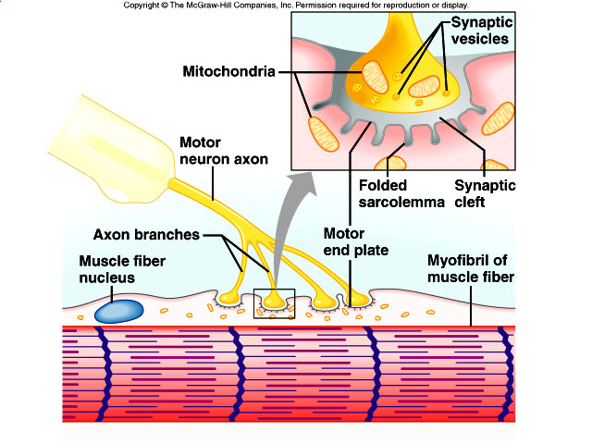

Slide 40
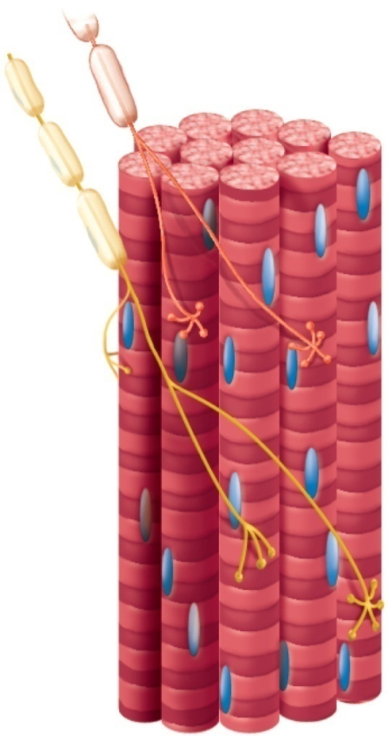
Neuromuscular Junction
A motor neuron and the muscle fibers that it controls make up a motor unit
A motor neuron may connect to as few as 4 muscle fibers and as many as 1000s of muscle fibers
When stimulated to do so, the muscle fibers of the motor unit contract all at once

Slide 41
Stimulus for Contraction
In skeletal muscle, neurotransmitter = Acetylcholine (ACh)
Nerve impulse travels down motor neuron to the neuromuscular junction, causing ACh to be released from synaptic vesicles
ACh crosses the synaptic cleft and binds to Ach receptors on the motor end plate which generates a muscle impulse
Muscle impulse travels down the T-tubule (through the muscle fiber) and eventually reaches the sarcoplasmic reticulum, causing calcium ions to be released.
Notes:
Neurotransmitter: a chemical substance that is released at the end of a neuron by a nerve impulse and, by diffusing across the synapse, causes the transfer of the impulse to another fiber (muscle fiber in this case)

Slide 42
Stimulus for Contraction
Calcium ions bind to troponin and change its shape and the position of tropomyosin is altered, allowing binding sites to be exposed
Myosin heads bind to the actin and form crossbridge, pulling the actin filament across the myosin filament and causing the sarcomere to shorten
New ATP binds to myosin, which cause actin and myosin to break apart
ATP splits into ADP and Pi (phosphate), which provides energy for the myosin head to go back to original position

Slide 43
Relaxation
Acetylcholinesterase – rapidly decomposes Ach remaining in the synapse
Muscle impulse stops
Stimulus to sarcolemma and muscle fiber membrane ceases
Calcium moves back into sarcoplasmic reticulum
Myosin and actin binding prevented
Muscle fiber relaxes

Slide 44
Energy Sources for Contraction
Energy for contraction comes from ATP molecules
Muscle cells have a limited amount of ATP
A couple seconds of activity will deplete the ATP in a muscle fiber
ATP must constantly be made available
So where does it come from?!?

Slide 45
Where does ATP come from?
Source/Process | Molecule that is broken down | When the process is used | Effect on the body
Aerobic Respiration (Cellular Respiration) | Fatty acids Glucose | When oxygen is present | Nothing major – ATP is released, with extra CO₂ and H₂O
Utilization of Creatine Phosphate | Creatine Phosphate | When oxygen supply first drops | 20 sec high energy 1 min moderate energy
Anaerobic Respiration | Glucose | When there is not enough oxygen present and CP has been exhausted | Produces lactic acid which can lead to muscle fatigue

Slide 46
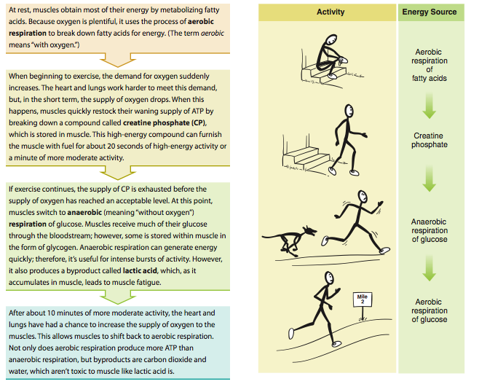

Slide 47
Oxygen Debt
During rest or moderate activity, there is enough oxygen to supply the muscle
Cells can use aerobic respiration to produce energy
Nothing bad comes out of it – just CO2, H20, and energy!
During strenuous activity, oxygen deficiency may develop
Cells have to use anaerobic respiration to produce energy
Lactic acid is a product – causes muscle fatigue

Slide 48
Oxygen Debt
The liver will attempt to convert the lactic acid back into glucose, however, during strenuous activity, more lactic acid is being created than the liver can keep up with
As a result, lactic acid builds up in the muscle tissue
When lactic acid accumulates in the muscle, the muscle loses its ability to contract, which is referred to as fatigue.
Following strenuous exercise, the liver continues to work to convert the lactic acid into glucose. However the process requires a lot of oxygen. The amount of oxygen required is known as oxygen debt.
Leads to breathing heavily following a hard workout

Slide 49
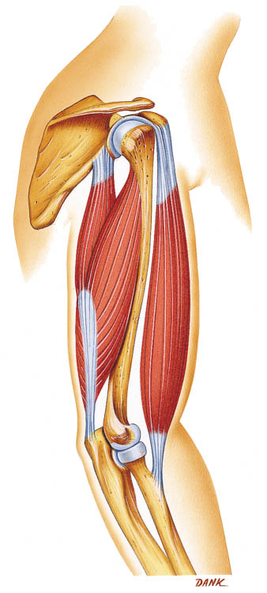
Skeletal Muscle Actions
Origin – muscle attachment that remains fixed (does not move)
Insertion – muscle attachment that moves on contraction
Action – body movement that a muscle produces
Flexion, extension, abduction, adduction, etc.

Slide 50
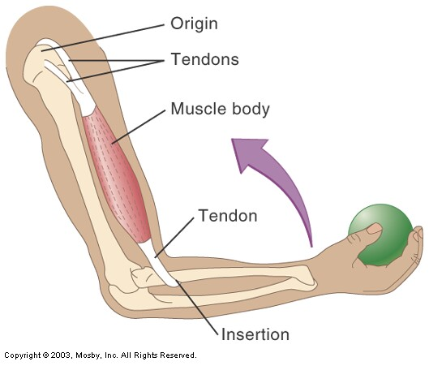
Does NOT move when
muscle contracts
Does move when
muscle contracts

Slide 51
Muscles Working Together
For muscles to create movement, they can only pull
Muscles in the body rarely work alone & are usually arranged in groups surrounding a joint
Agonist/Prime mover – a muscle that contracts to perform the desired action
Synergist - A muscle that helps the agonist
Antagonist - A muscle that opposes the action of the agonist, therefore undoing the desired action

Slide 52
Muscle Growth and Size
Hypertrophy – enlargement of muscle
Due to strenuous activity
More actin and myosin filaments are formed (NOT muscle fibers!)
Muscle fiber diameter increases in size
Atrophy – decrease in muscle size
With lack of exercise
Loss of actin and myosin filaments
Muscle fiber diameter decrease in size

Slide 53
Types of Muscle Fibers
 | Slow Twitch (Type 1) | Fast Twitch (Type 2)
Amt. of Mitochondria | Lots | Less
Blood Supply | Good (aerobic activity) | Poor (anaerobic activity)
Speed of Contraction | Slow | Fast
Time until Fatigue | Long time (longer to fatigue) | Short time (fatigue easily)
Type of Athlete/Sport | Endurance based (Marathon runners) | Speed/Strength based (Weight lifters/Sprinters)
Notes:
Slow – lots of mitochondria – produce the ATP for the muscle fiber = almost limitless energy Fast – few mitochondria – not as much ATP – leads to anaerobic respiration = fatigue quickly Fast – larger diameter and higher growth potential (big and bulky) – bigger cross section = bigger force
Slow – smaller diameter and low growth potential (long and lean) – less powerful but low amounts of force for long period of time

Slide 54
Muscle Fiber Types and Performance
Power Athletes
Sprinters
Have a high % of fast fibers
Endurance Athletes
Distance runners
Have a high % of slow fibers
Others
Nonathletes
50% slow fibers and 50% fast fibers

Slide 55
Types of Muscle Contractions
When skeletal muscles contract, they may produce two types of contractions:
Isotonic Contraction
Isometric Contraction

Slide 56
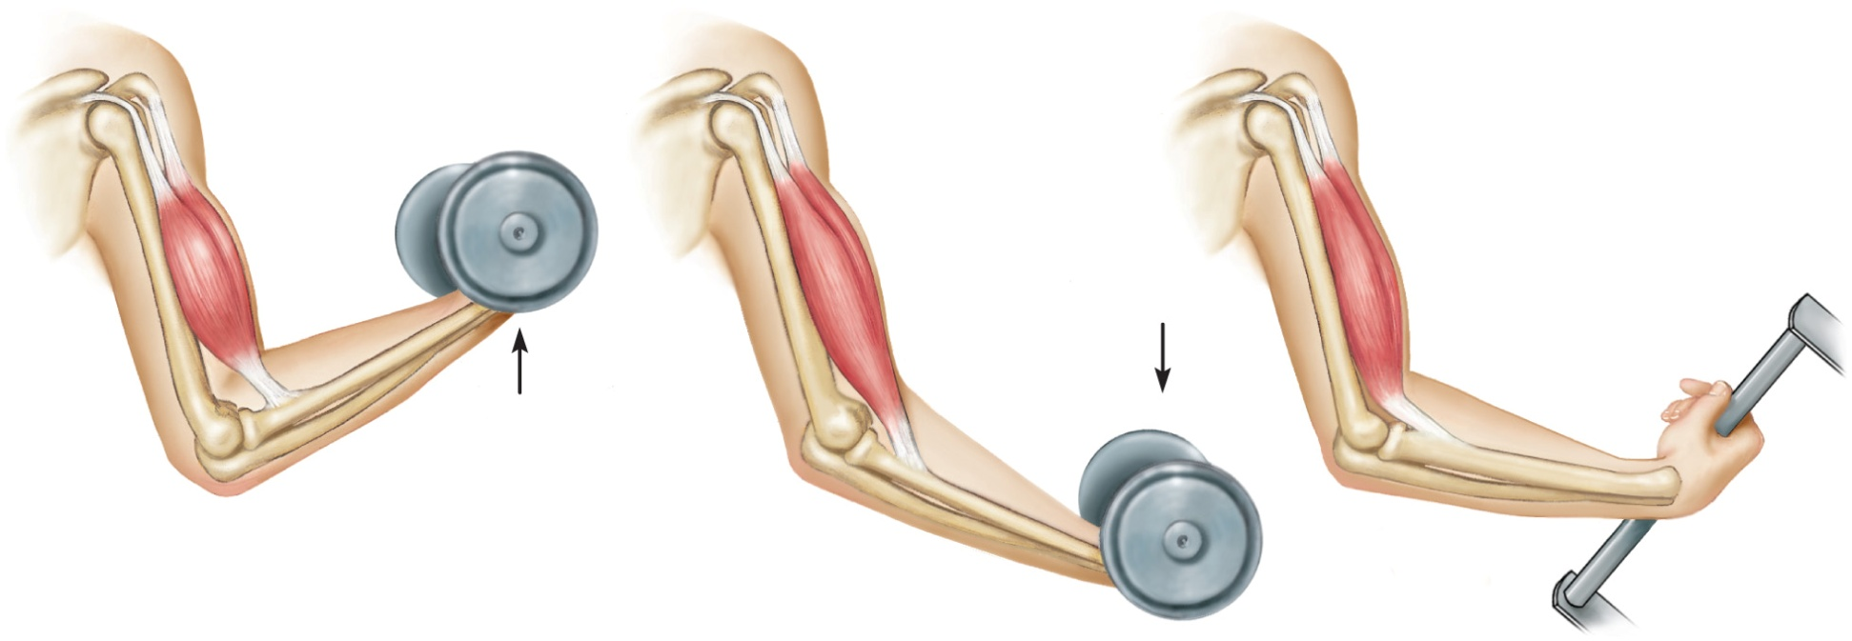
Types of Muscle Contractions
Isotonic Contraction
The tension (load) on a muscle stays constant during movement
Length of muscle changes, usually resulting in movement of a joint
Two Types
Concentric – shortening a contraction
Eccentric – lengthening a contraction
(a) Muscle contracts with
force greater than
resistance and
shortens (concentric
contraction)
Movement
Movement
(b) Muscle contracts
with force less than
resistance and
lengthens (eccentric
contraction)
Notes:
Examples – lifting a baby, picking up an object, walking, etc.

Slide 57
Types of Muscle Contraction
Isometric Contraction
The tension (load) on a muscle increases
Length of muscle does not change
Example: holding a baby at arms length, pushing against a closed door
Necessary in everyday life to counteract effects of gravity
Example: postural muscles keeping head up
Notes:
T

Slide 59
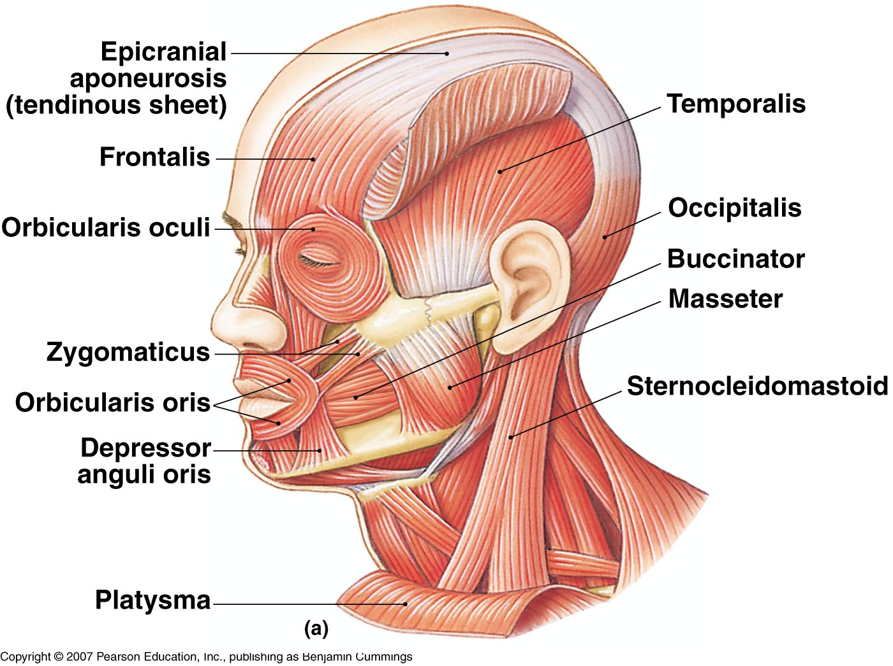
Muscles of the Head, Face, and Neck
Figure 7-12(a)

Slide 60
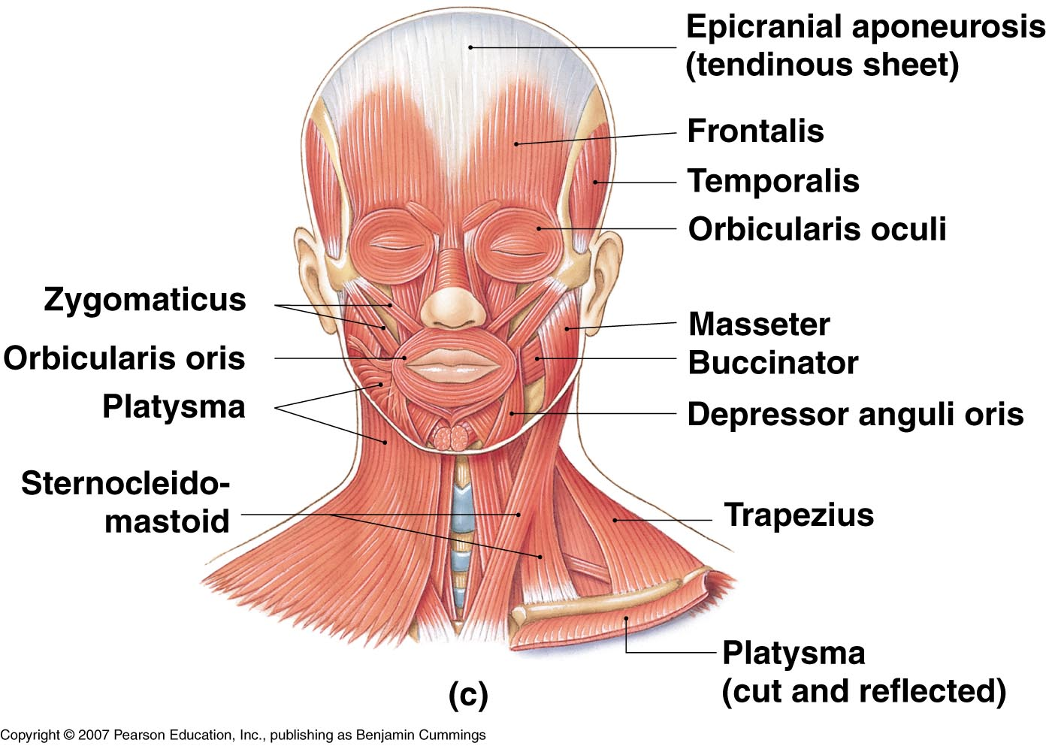
Muscles of the Head, Face, and Neck
Figure 7-12(c)

Slide 61
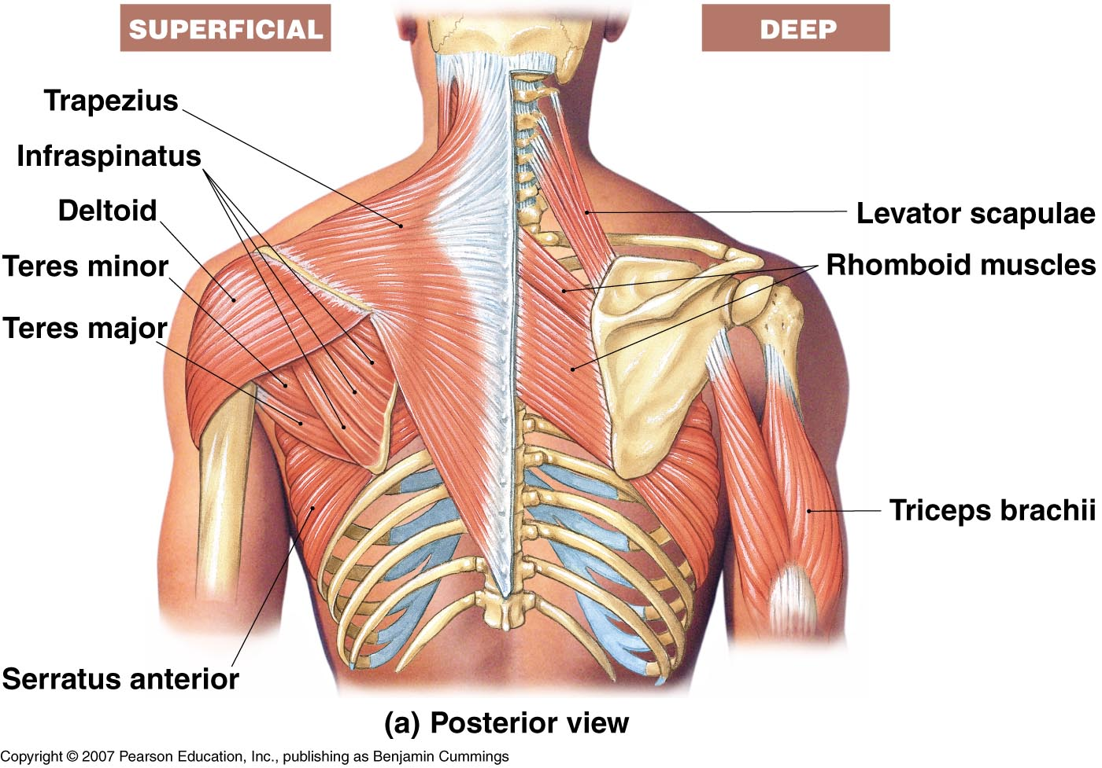
Muscles of the Chest, Back, and Shoulder
Figure 7-17(a)

Slide 62
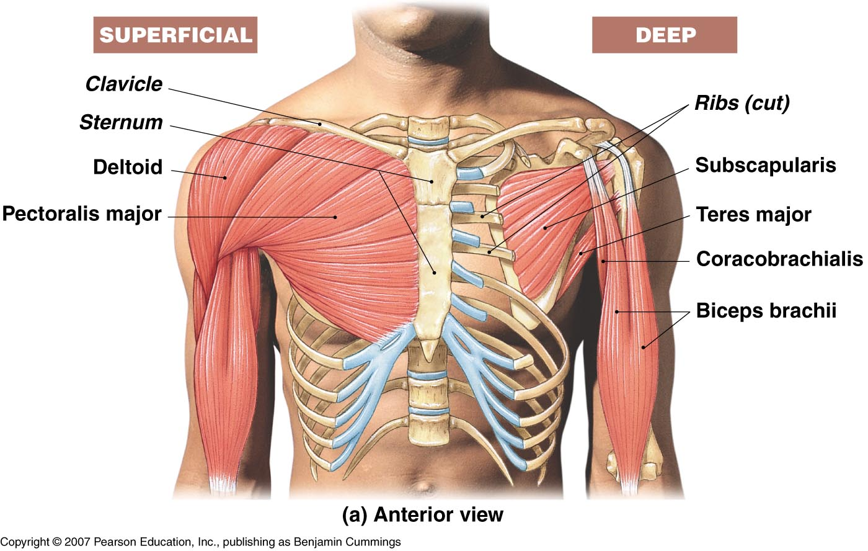
Muscles of the Chest, Back, and Shoulder
Figure 7-18(a)

Slide 63
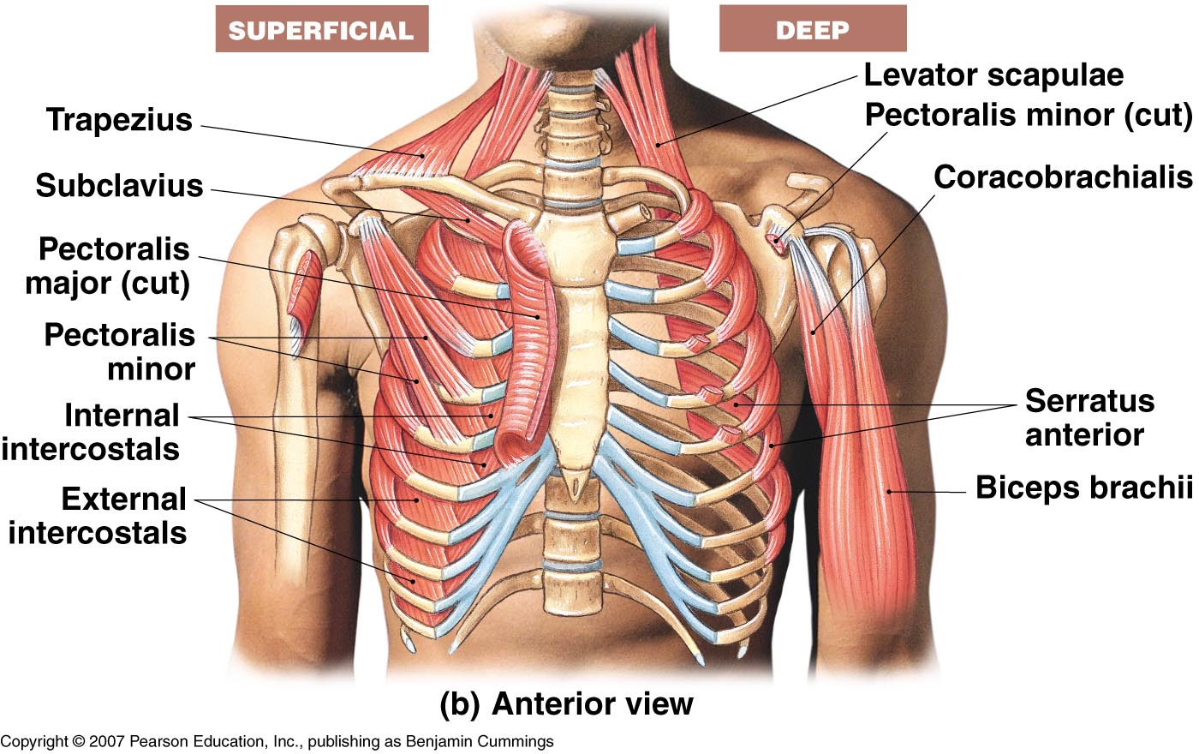
Muscles of the Chest, Back, and Shoulder
Figure 7-17(b)

Slide 64
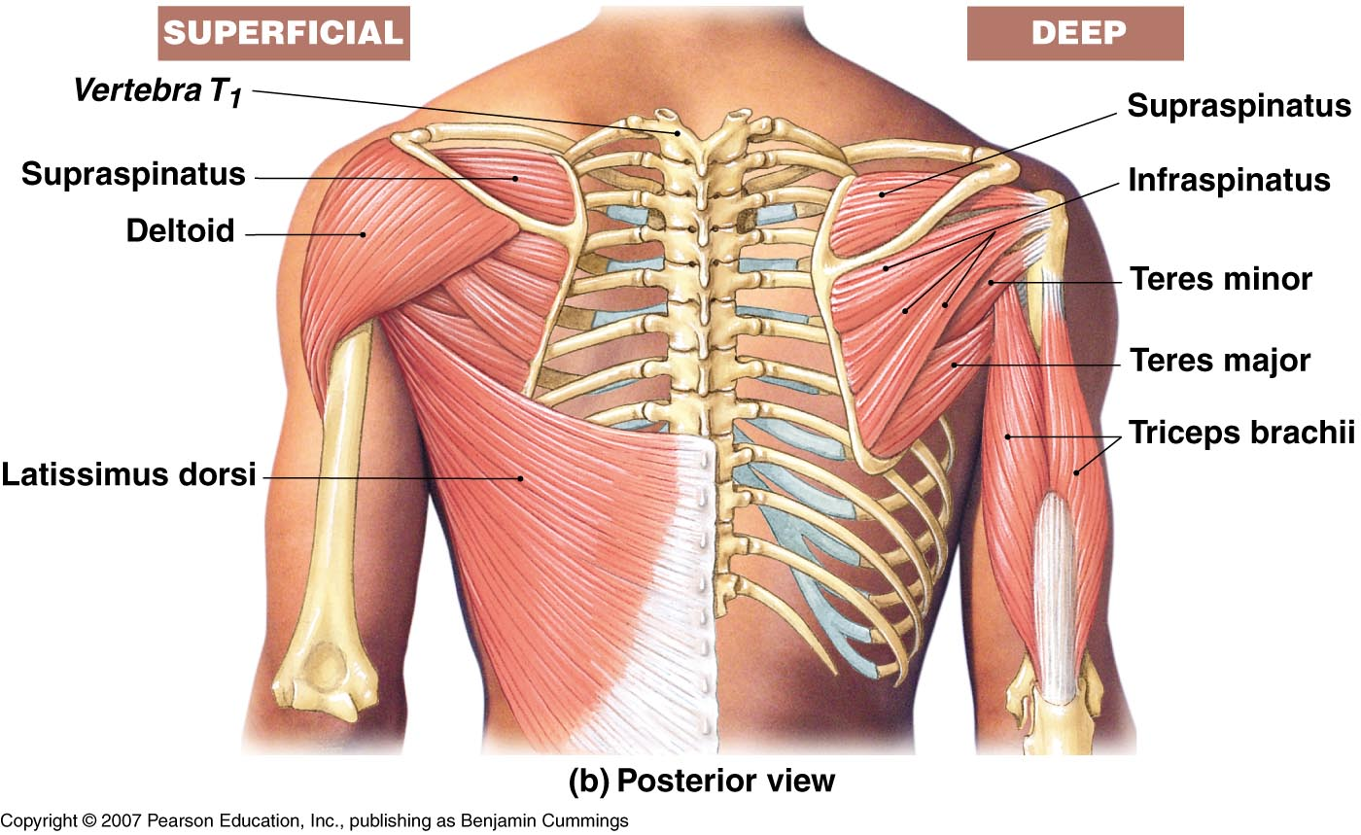
Muscles of the Chest, Back, and Shoulder
Figure 7-18(b)

Slide 65
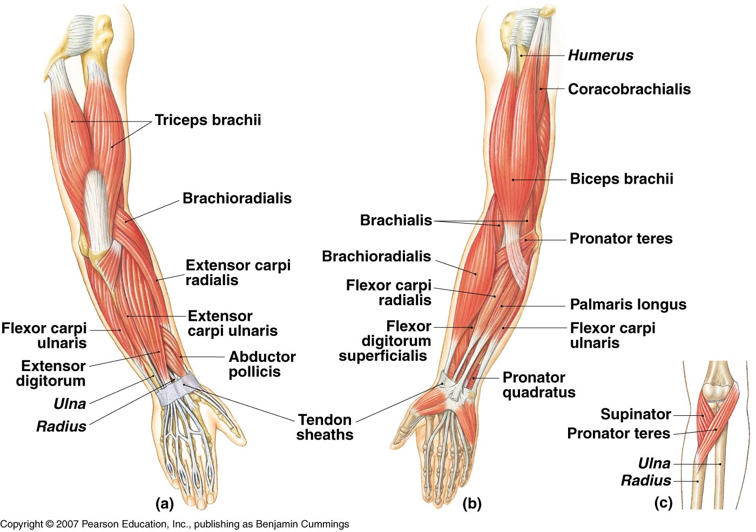
Muscles of the Arm and Forearm
Figure 7-19

Slide 66
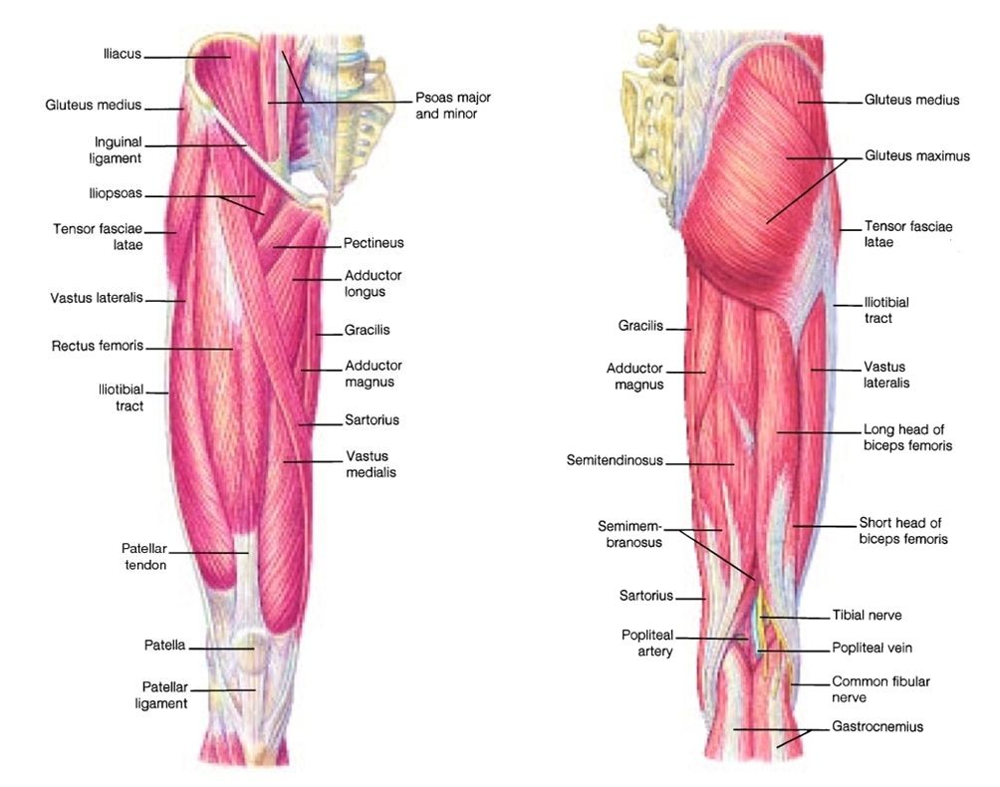
Muscles of the Hip, Leg, Foot

Slide 67
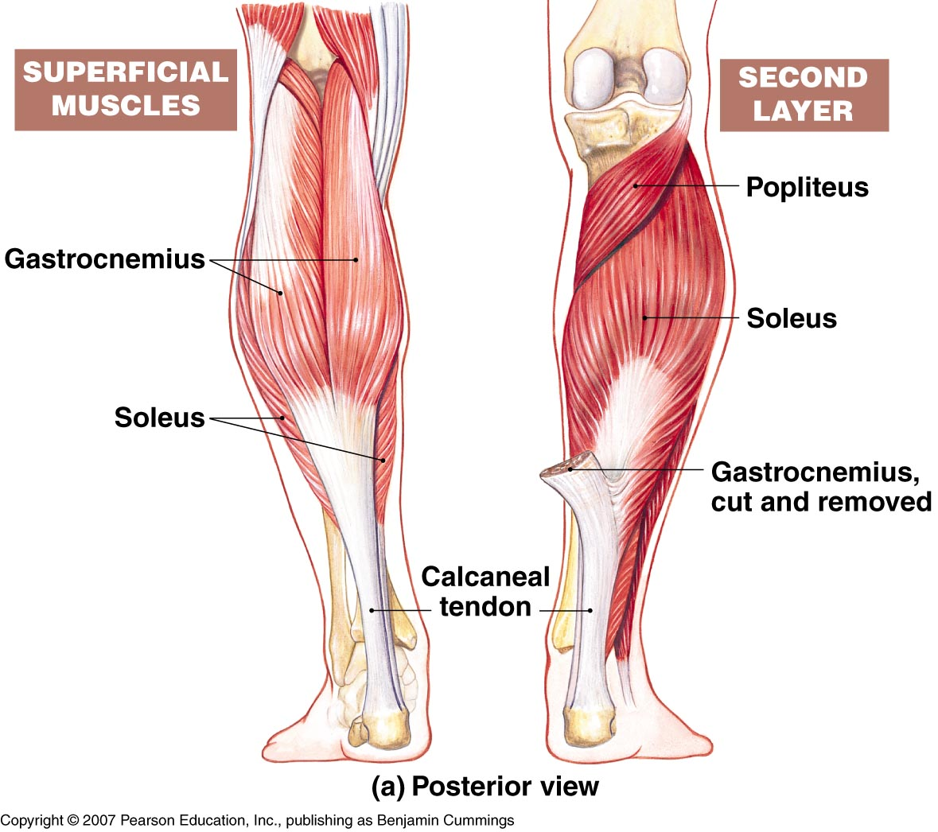
Muscles of the Hip, Leg, Foot
Figure 7-22(a)

Slide 68
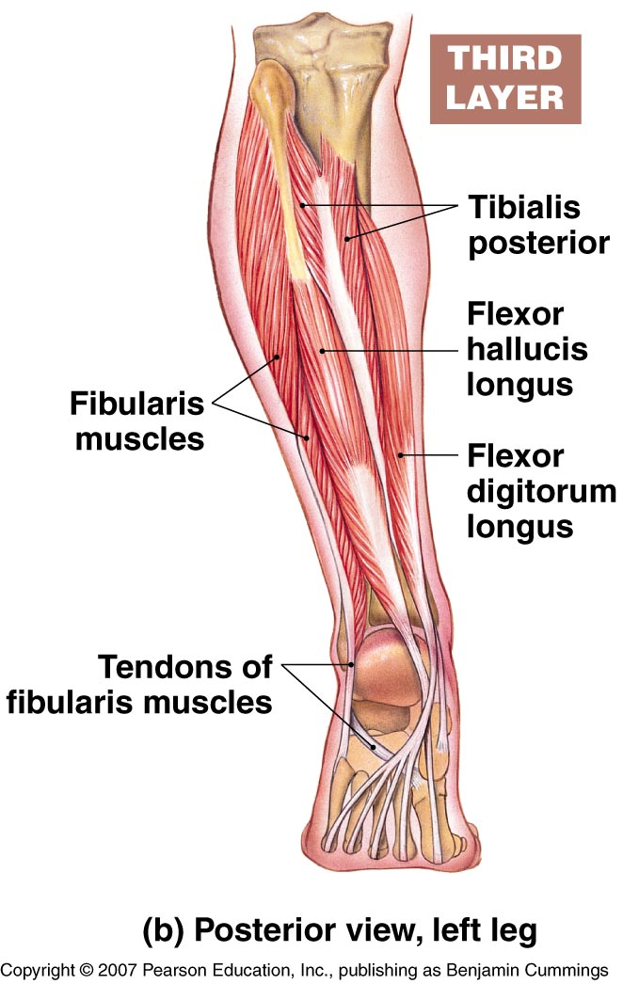
Muscles of the Hip, Leg, Foot
Figure 7-22(b)

Slide 69
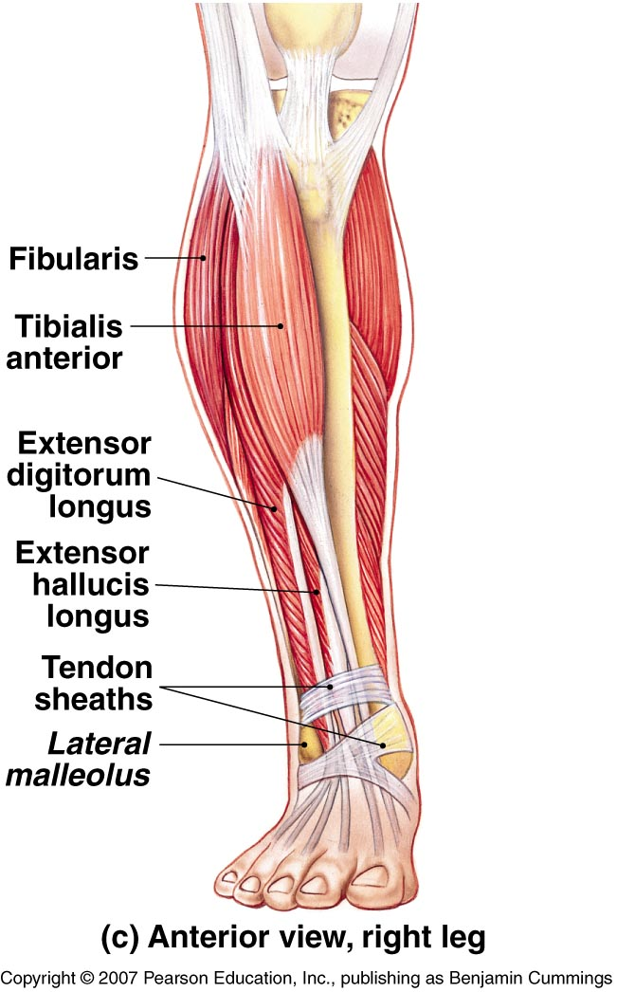
Muscles of the Hip, Leg, Foot

Slide 70
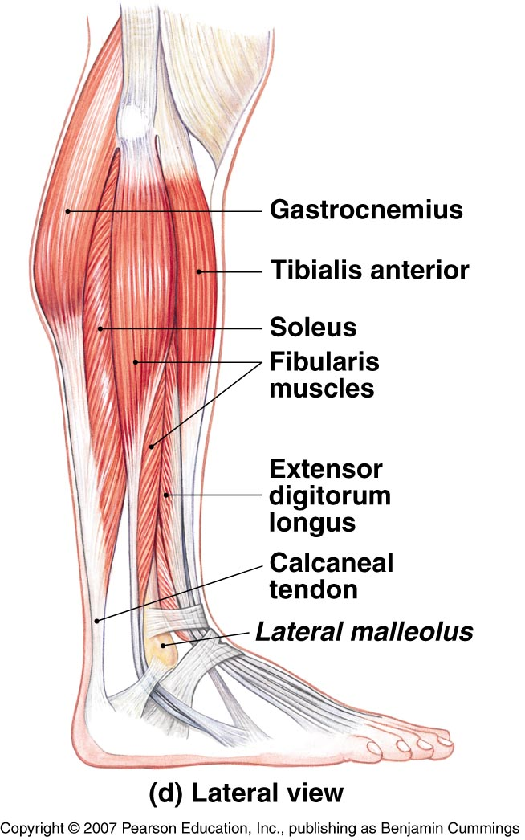
Muscles of the Hip, Leg, Foot

