Slide 1
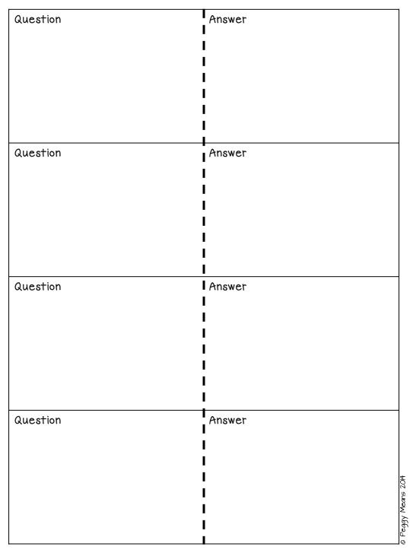
Root Word:
myo-
Muscle
Root Word:
-cyte
Cell
Root Word:
hema(o)-
Blood
Root Word:
pleura(o)-
Lungs

Slide 2
Which body system is responsible for providing body movement and posture?
Muscular System
Which body system is responsible for covering and protecting the body and regulating body temperature?
Integumentary System
What are the 5 things required for the maintenance of life?
Water
Food
Oxygen
Heat
Pressure
What are the three parts of a homeostatic mechanism?
Receptor
Control Center
Effector

Slide 3
The elbow is _______ to the wrist
Proximal
The ears are _________ to the nose.
Lateral
The ventral cavity is _______ to the dorsal cavity
Anterior
The sternal region is ______ to the cervical region.
Inferior

Slide 4
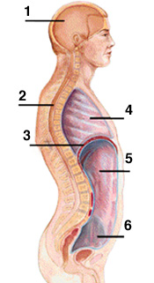
What body cavity is #4?
Thoracic
What body cavity is #2?
Spinal/Vertebral
#1 and #2 make up the _______ cavity.
Dorsal
#5 and #6 make up the _______ cavity.
Abdominopelvic

Slide 5
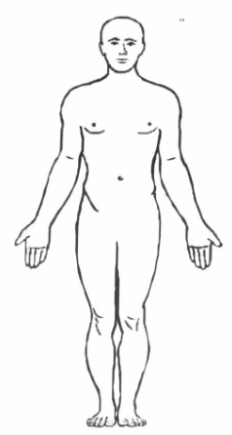
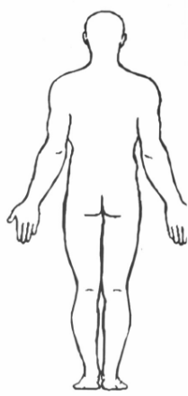
What body region is the arrow pointing to?
Femoral
What body region is the arrow pointing to?
Brachial
What body region is the arrow pointing to?
Gluteal
What body region is the arrow pointing to?
Occipital

Slide 6
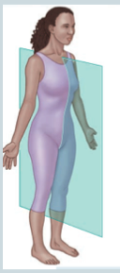
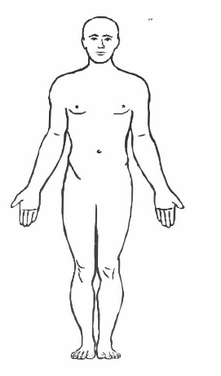
What type of body section/plane is shown?
Sagittal
Which body system is responsible for providing supporting framework and producing new blood cells?
Skeletal
Which body system is responsible for transportation of oxygen to cells and removal of waste from cells?
Cardiovascular
Demonstrate anatomical position.

Slide 7
What is the difference between a negative and positive feedback mechanism?
Negative: Change occurs, body brings it back to normal
Positive: Change occurs, body encourages the change to continue
________ is the study of the functions of the human body’s parts and systems.
Physiology
What is the anatomical term for the body region of the eye?
Orbital
What is the anatomical term for the body region of the cheek?
Buccal

